Slide 1

KNOWLEDGE INSTITUTE OF TECHNOLOGY
DEPARTMENT OF ECE
Digital Communications
Prepared By
Mrs.NEELAVATHI M.E
ASSISTANT PROFESSOR/ECE

Slide 2
Communication
Main purpose of communication is to transfer information from a
source to a recipient via a channel or medium.
Basic block diagram of a communication system:
Source
Transmitter
Channel
Receiver
Recipient

Slide 3
Brief Description
Source: analog or digital
Transmitter: transducer, amplifier, modulator, oscillator, power amp., antenna
Channel: e.g. cable, optical fibre, free space
Receiver: antenna, amplifier, demodulator, oscillator, power amplifier,
transducer
Recipient: e.g. person, (loud) speaker, computer

Slide 4
Types of information
Voice, data, video, music, email etc.
Types of communication systems
Public Switched Telephone Network (voice,fax,modem)
Satellite systems Radio,TV broadcasting Cellular phones
Computer networks (LANs, WANs, WLANs)

Slide 5
Information Representation
Communication system converts information into electrical
electromagnetic/optical signals appropriate for the transmission medium.
Analog systems convert analog message into signals that can propagate
through the channel.
Digital systems convert bits(digits, symbols) into signals
  Computers naturally generate information as characters/bits
  Most information can be converted into bits
  Analog signals converted to bits by sampling and quantizing (A/D
conversion)

Slide 6
Why digital?
Digital techniques need to distinguish between discrete symbols allowing regeneration versus amplification
Good processing techniques are available for digital signals, such as
medium.
❑ Data compression (or source coding)
❑ Error Correction (or channel coding)(A/D conversion)
❑ Equalization
❑ Security
Easy to mix signals and data using digital techniques

Slide 7
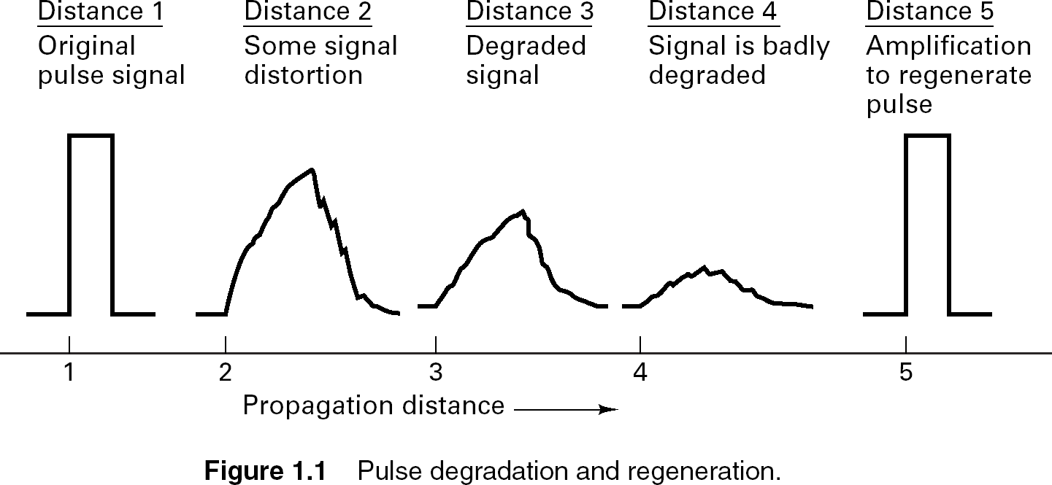

Slide 8
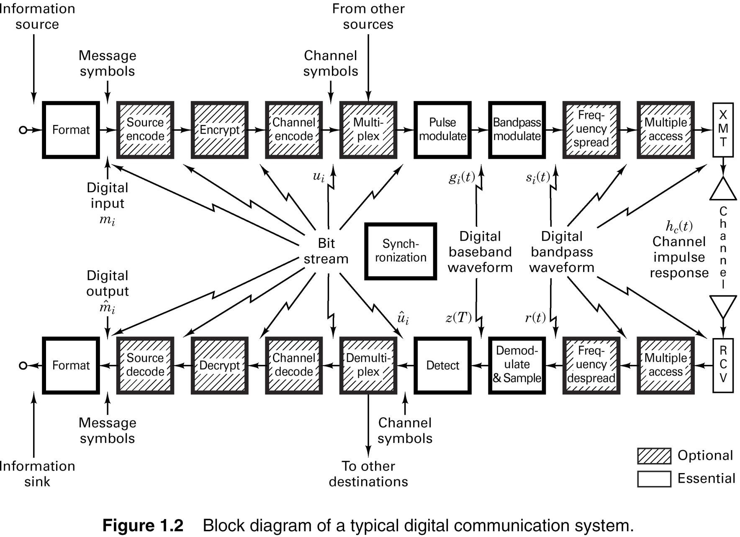

Slide 9
Basic Digital Communication Transformations
  Formatting/Source Coding
  Transforms source info into digital symbols (digitization)
  Selects compatible waveforms (matching function)
  Introduces redundancy which facilitates accurate decoding
despite errors
It is essential for reliable communication
  Modulation/Demodulation
  Modulation is the process of modifying the info signal to
facilitate transmission
  Demodulation reverses the process of modulation. It involves
the detection and retrieval of the info signal
    Types
    Coherent: Requires a reference info for detection
    Noncoherent: Does not require reference phase information

Slide 10
Basic Digital Communication Transformations
Coding/Decoding
Translating info bits to transmitter data symbols
Techniques used to enhance info signal so that they are less vulnerable to channel impairment (e.g. noise, fading, jamming, interference)
  Two Categories
    Waveform Coding
  Produces new waveforms with better performance
    Structured Sequences
Involves the use of redundant bits to determine the occurrence of error (and sometimes correct it)
  Multiplexing/Multiple Access Is synonymous with resource
sharing with other users
  Frequency Division Multiplexing/Multiple Access (FDM/FDMA

Slide 11
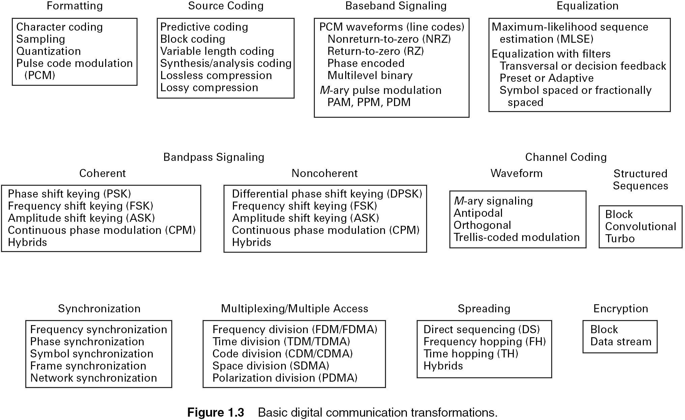

Slide 12
Main Points
Transmitters modulate analog messages or bits in case of a DCS for transmission over a channel.
Receivers recreate signals or bits from received signal (mitigate channel effects)
Performance metric for analog systems is fidelity, for digital it is the bit
rate and error probability.

Slide 13
Why Digital Communications?
Easy to regenerate the distorted signal
Regenerative repeaters along the transmission path can detect a
digital signal and retransmit a new, clean (noise free) signal
These repeaters prevent accumulation of noise along the path
This is not possible with analog communication systems
  Two-state signal representation
The input to a digital system is in the form of a sequence of bits (binary or M_ary)
  Immunity to distortion and interference
  Digital communication is rugged in the sense that it is more immune to channel noise and distortion

Slide 14
Why Digital Communications?
Hardware is more flexible
Digital hardware implementation is flexible and permits the use of microprocessors, mini-processors, digital switching and VLSI
Shorter design and production cycle
  Low cost
The use of LSI and VLSI in the design of components and systems have resulted in lower cost
  Easier and more efficient to multiplex several digital signals
  Digital multiplexing techniques – Time & Code Division Multiple Access - are easier to implement than analog techniques such as Frequency Division Multiple Access

Slide 15
Why Digital Communications?
Can combine different signal types – data, voice, text, etc.
Data communication in computers is digital in nature whereas
voice communication between people is analog in nature
The two types of communication are difficult to combine over
the same medium in the analog domain.
Using digital techniques, it is possible to combine both format for transmission through a common medium
Encryption and privacy techniques are easier to
implement
  Better overall performance
  Digital communication is inherently more efficient than analog
in realizing the exchange of SNR for bandwidth
  Digital signals can be coded to yield extremely low rates and high fidelity as well as privacy

Slide 16
Disadvantages
Why Digital Communications?
Requires reliable “synchronization”
Requires A/D conversions at high rate
Requires larger bandwidth
Nongraceful degradation
Performance Criteria
Probability of error or Bit Error Rate

Slide 17
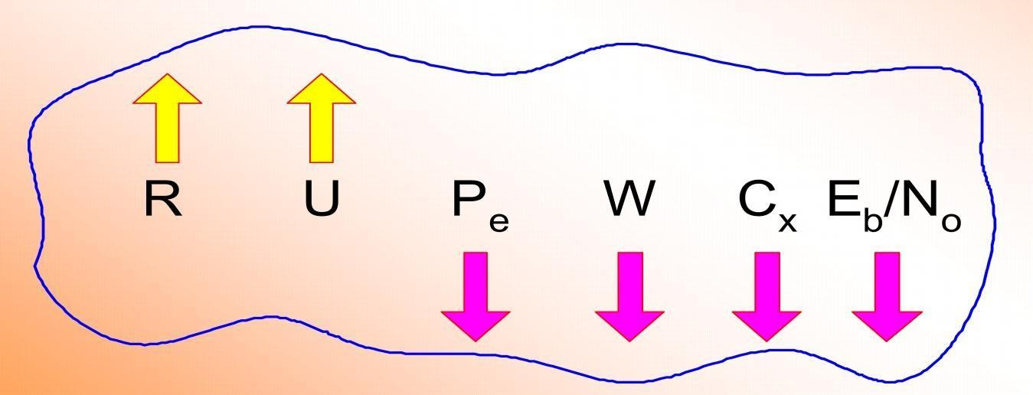
Goals in Communication System Design
To maximize transmission rate, R
To maximize system utilization, U
To minimize bit error rate, Pe
To minimize required systems bandwidth, W
To minimize system complexity, Cx
To minimize required power, Eb/No

Slide 18
Digital Signal Nomenclature
Information Source
  Discrete output values e.g. Keyboard
  Analog signal source e.g. output of a microphone
Character
  Member of an alphanumeric/symbol (A to Z, 0 to 9)
  Characters can be mapped into a sequence of binary digits using
one of the standardized codes such as
    ASCII: American Standard Code for Information Interchange
    EBCDIC: Extended Binary Coded Decimal Interchange Code

Slide 19
Digital Signal Nomenclature
Digital Message
  Messages constructed from a finite number of symbols; e.g., printed language consists of 26 letters, 10 numbers, “space” and several punctuation marks. Hence a text is a digital message constructed from about 50 symbols
  Morse-coded telegraph message is a digital message constructed from two
symbols “Mark” and “Space”
M - ary
  A digital message constructed with M symbols
Digital Waveform
  Current or voltage waveform that represents a digital symbol
Bit Rate
  Actual rate at which information is transmitted per second

Slide 20
Digital Signal Nomenclature
Baud Rate
  Refers to the rate at which the signaling elements are
transmitted, i.e. number of signaling elements per second.
Bit Error Rate
  The probability that one of the bits is in error or simply the probability of error

Slide 21
Digital Pulse Modulation
The process of Sampling which we have already discussed in initial slides is also adopted in Digital pulse modulation.
It is mainly of two types:
Pulse Code Modulation(PCM)
Delta Modulation(DM)

Slide 22
Pulse Code Modulation(PCM)
Pulse-Code Modulation (PCM) is the most commonly used digital modulation scheme
In PCM, the available range of signal voltages is divided into levels and each is assigned a binary number
Each sample is represented by a binary number and transmitted serially
The number of levels available depends upon the number of bits used to express the sample value
The number of levels is given by: N = 2^{m}
22
22

Slide 23
Pulse Code Modulation(PCM)
PCM consists of three steps to digitize an analog signal:
  Sampling
  Quantization
  Binary encoding
Before we sample, we have to filter the signal to limit the maximum frequency of the signal .Filtering should ensure that we do not distort the signal, ie remove high frequency components that affect the signal shape.
23
23

Slide 24
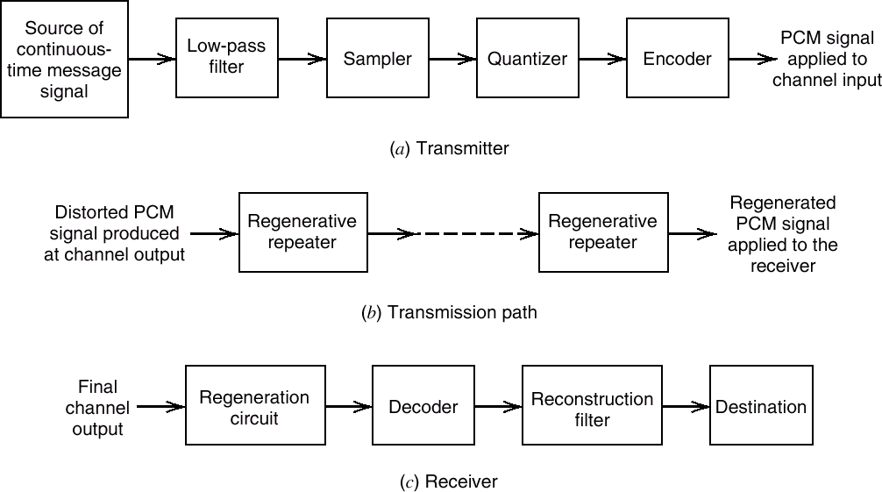
Pulse Code Modulation(PCM)
The basic elements of a PCM system.
24
24

Slide 25
Pulse Code Modulation(PCM)
Analog to digital converter employs two techniques:
1. Sampling: The process of generating pulses of zero width and of amplitude equal to the instantaneous amplitude of the analog signal. The no. of pulses per second is called “sampling rate”.
25
25

Slide 26
Pulse Code Modulation(PCM)
 2. Quantization: The process of dividing the maximum value of the analog signal into a fixed no. of levels in order to convert the PAM into a Binary Code.
The levels obtained are called “quanization levels”.
26
25

Slide 27
V
Sampling, Quantization and Coding
o
l t a g e
Time
L
e v e l s
7
6
5
4
3
2
1
0
V
111
110
101
100
011
010
001
000
B
i n a r y
C
o
d e s
Time
0 1 0 1 0 1 1 1 0 1 1 1 1 1 0 1 0 1 0 1 0
o
l t a g e
Time
27
27

Slide 28
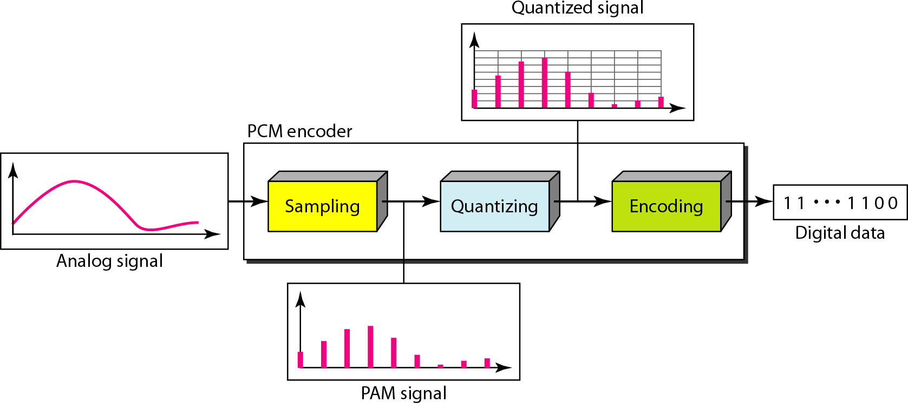
Pulse Code Modulation(PCM)
28
30

Slide 29
Quantization
By quantizing the PAM pulse, original signal is only approximated
The process of converting analog signals to PCM is called quantizing
Since the original signal can have an infinite number of signal levels, the quantizing process will produce errors called quantizing errors or quantizing noise
29
30

Slide 30
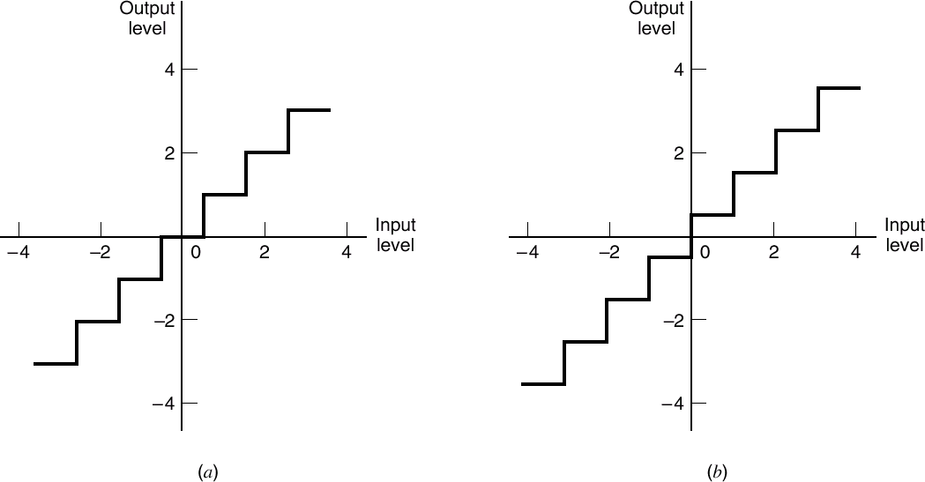
Quantization
Two types of quantization: (a) midtread and (b) midrise
30
30

Slide 31
Quantization
Coding and Decoding
The process of converting an analog signal into PCM is called coding, the inverse operation is called decoding
Both procedures are accomplished in a CODEC
31
30

Slide 32
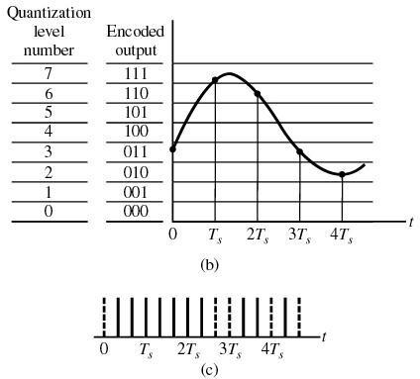
Quantization
32
30

Slide 33
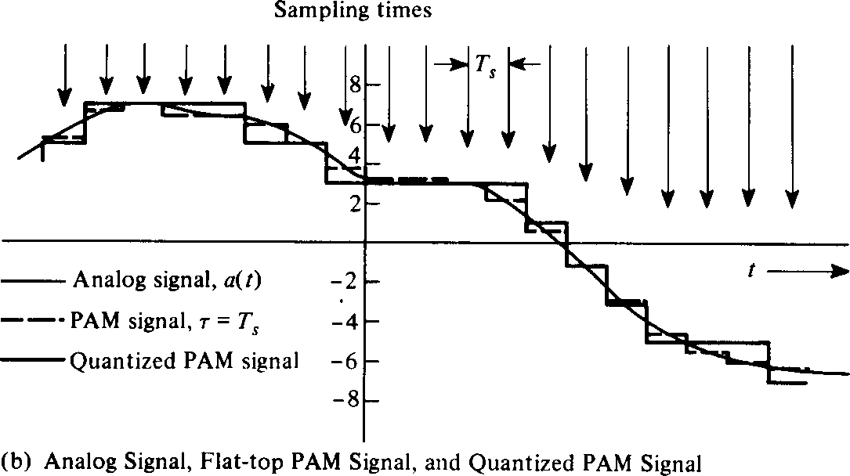
Quantization
33
30

Slide 34
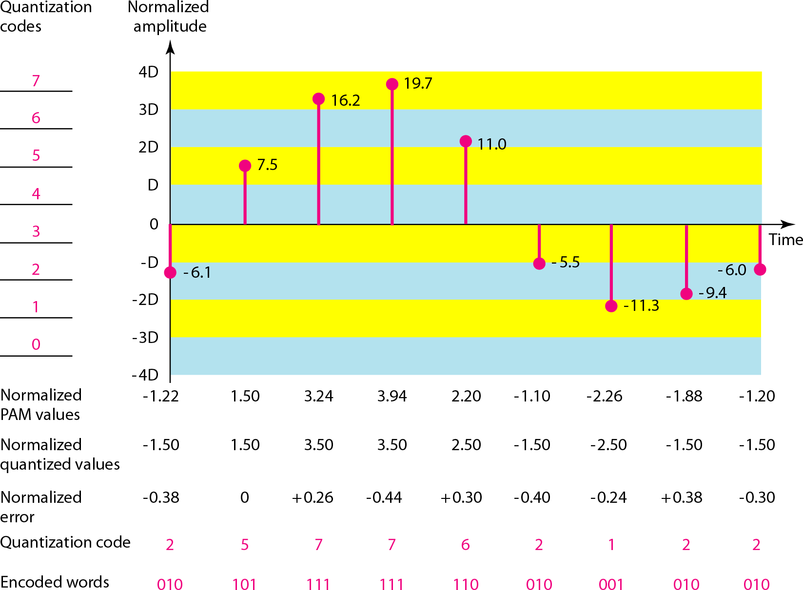
Quantization and encoding of a sampled signal
34
30

Slide 35
Quantization Error
When a signal is quantized, we introduce an error - the coded signal is an approximation of the actual amplitude value.
The difference between actual and coded value (midpoint) is referred to as the quantization error.
The more zones, the smaller Δ which results in smaller errors.
BUT, the more zones the more bits required to encode the samples -> higher bit rate
35
30

Slide 36
Quantization Error (cont.)
Round-off error
Overload error
Overload
36
30

Slide 37
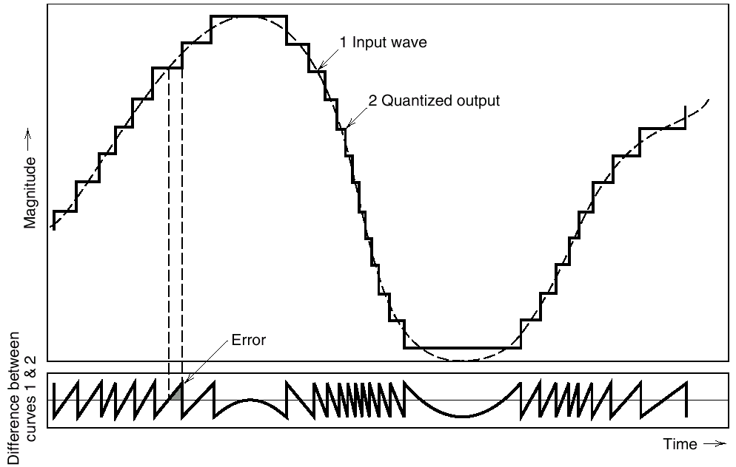
Quantization Noise
Illustration of the quantization process
37
37

Slide 38
Pulse Code Modulation
In PCM system,N number of binary digits are transmitted per sample.Hence the signaling rate and channel bandwidth of PCM are very large.
Also encodind,decoding and quantizing circuitary of PCM is complex.
38
38

Slide 39
Delta Modulation
In Delta Modulation, only one bit is transmitted per sample
That bit is a one if the current sample is more positive than the previous sample, and a zero if it is more negative
Since so little information is transmitted, delta modulation requires higher sampling rates than PCM for equal quality of reproduction
39

Slide 40
Delta Modulation
This scheme sends only the difference between pulses, if the pulse at time t_{n+1} is higher in amplitude value than the pulse at time t_{n}, then a single bit, say a “1”, is used to indicate the positive value.
If the pulse is lower in value, resulting in a negative value, a “0” is used.
This scheme works well for small changes in signal values between samples.
If changes in amplitude are large, this will result in large errors.
40
41

Slide 41
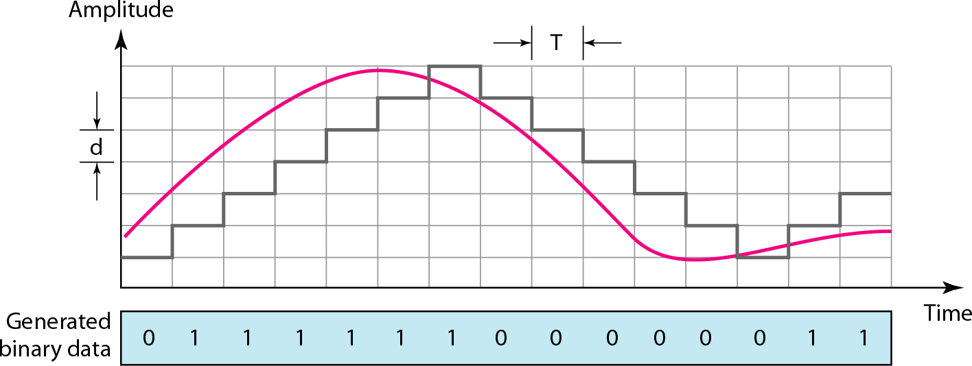
Delta Modulation
The process of delta modulation
41
41

Slide 42
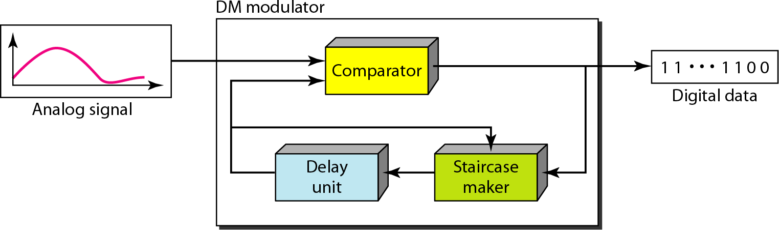
Delta Modulation
Components of Delta Modulation
42
41

Slide 43
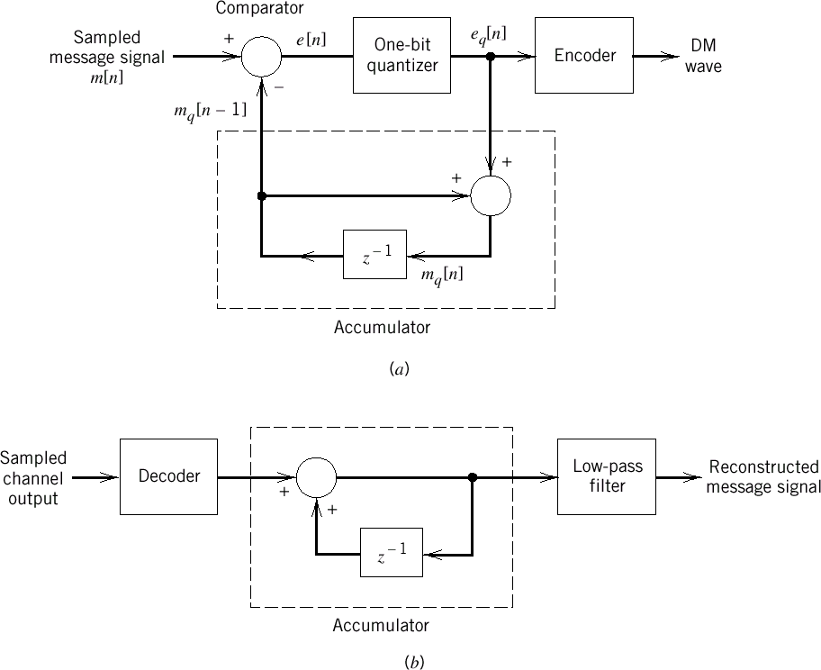
Delta Modulation
DM system. (a) Transmitter. (b) Receiver.
43
43

Slide 44
Delta Modulation
 Distortions in DM system
If the slope of analog signal is much higher than that of approximated digital signal over long duration,than this difference is called Slope overload distortion.
The difference between quantized signal and original signal is called as Granular noise. It is similar to quantisation noise.
44
44

Slide 45
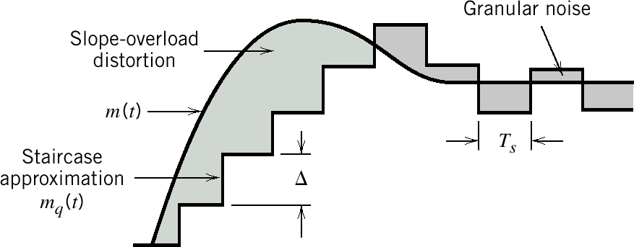
Delta Modulation
Two types of quantization errors :
Slope overload distortion and granular noise
45
44

Slide 46
Delta Modulation
Distortions in DM system
Granular noise occurs when step size▲ is large relative to local slope m(t).
There is a further modification in this system,in which step size is not fixed.
That scheme is known as Adaptive Delta Modulation.
46
44

Slide 47
Adaptive Delta Modulation
A better performance can be achieved if the value of ▲ is not fixed.
The value of ▲ changes according to the amplitude of the analog signal.
It has wide dynamic range due to variable step size.
Also better utilisation of bandwidth as compared to delta modulation.
Improvement in signal to noise ratio.
47
44

Slide 48
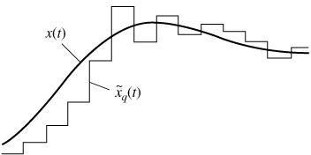
Adaptive Delta Modulation
48
44

Slide 49
Unit 2
Digital Band-Pass Modulation Techniques

Slide 50
Digital band-pass modulation techniques
  Amplitude-shift keying
  Phase-shift keying
  Frequency-shift keying
Receivers
  Coherent detection
    The receiver is synchronized to the transmitter with respect to carrier phases
  Noncoherent detection
    The practical advantage of reduced complexity but at the cost of degraded performance

Slide 51
Some Preliminaries
Given a binary source
  The modulation process involves switching ore keying the amplitude, phase, or frequency of a sinusoidal carrier wave between a pair of possible values in accordance with symbols 0 and 1.
c ( t ) = A c o s ( 2 π f t + ϕ )
c c c
  All three of them are examples of a band-pass process
1. Binary amplitude shift-keying (BASK)
The carrier amplitude is keyed between the two possible values used to represent symbols 0
and 1
Binary phase-shift keying (BPSK)
Binary frequency-shift keying (BFSK)
The carrier phase is keyed between the two possible values used to represent symbols 0 and 1.
The carrier frequency is keyed between the two possible values used to represent symbols 0 and 1.

Slide 52
– Decreasing the bit duration T_{b} has the effect of increasing the transmission bandwidth requirement of a binary modulated wave.
2
T_{b}
A =
c
c ( t) =
² cos( 2 π f t + φ )
( 7 .3 )
T
c
c
b
Differences that distinguish digital modulation from analog modulation.
  The transmission bandwidth requirement of BFSK is greater than that of BASK for
a given binary source.
  However, the same does not hold for BPSK.

Slide 53
Band-Pass Assumption
  The spectrum of a digital modulated wave is centered on the carrier
frequency f_{c}
  Under the assumption f_{c}>>W,
    There will be no spectral overlap in the generation of s(t)
    The spectral content of the modulated wave for positive frequency is essentially separated from its spectral content for negative frequencies.
s ( t ) = b ( t ) c ( t ) ( 7 .4 )
s ( t) =
² b ( t ) cos( 2 π f t )
( 7 .5 )
T
c
b
– The transmitted signal energy per bit
E = ∫
T
b
s ( t ) ² dt
b
0
2
T
b
2
=
∫
b ( t )
cos ² ( 2 π f t ) dt
( 7 .6 )
T
0
c
b

Slide 54
1
cos ( 2 π f t ) = [1 + cos( 4 π f t )]
2
c c
2
1
E =
1
T
b
2
T
b
2
cos ² ( 4 π f t ) dt
∫
b ( t ) dt +
∫
b ( t )
( 7 .7 )
b
T
0
T
0
c
b
b
– The band-pass assumption implies that |b(t)|² is essentially constant
over one complete cyT _{b}cle of the sinusoidal wave cos(4πf t)
∫
b ( t )
2
cos ² ( 4 π f t ) dt ≈ 0
c
c
0
E ≈
1
T
b
2
∫
b ( t ) dt ( 7 .8 )
b
T
0
b
– For linear digital modulation schemes governed by Eq.(7.5), the transmitted signal energy is a scaled version of the energy in the incoming binary wave responsible for modulating the sinusoidal carrier.

Slide 55
7.2 Binary Amplitude-Shift Keying
– The ON-OFF signaling variety
⎧
b ( t ) = ⎨
⎩ 0 ,
E ,
for binary symbol 1
for binary symbol 0
b
(7 .9 )
⎧ 2 E
⎪
^{b} cos( 2 π f t ),
for symbol 1
s ( t ) = ⎨
T
c
(7 .10 )
b
⎪⎩0, for symbol 0
– The average transmitted signal energy is ( the two binary symbols must by
equiprobable)
E
2
E =
b
( 7 .11 )
av

Slide 56
Generation and Detection of ASK Signals
  Generation of ASK signal : by using a produce modulator with two inputs
    The ON-OFF signal of Eq. (7.9)
⎧ E ,
b ( t ) = ⎨
⎩ 0 ,
for binary symbol 1
for binary symbol 0
b
( 7 .9 )
The sinusoidal carrier wave
2
c ( t ) =
cos( 2 π f t )
T
c
b
Detection of ASK signal
  The simplest way is to use an envelope detector, exploiting the nonconstant-
envelope property of the BASK signal

Slide 57
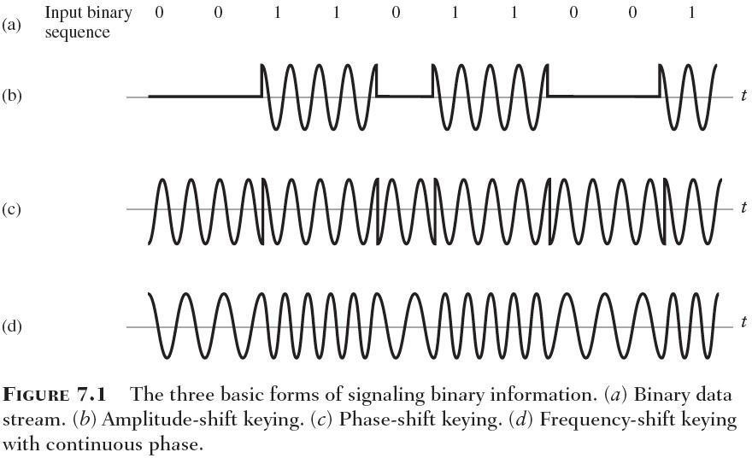

Slide 58
Spectral Analysis of BASK
  The objective
    To investigate the effect of varying the carrier frequency fc on the power spectrum of the BASK signal s(t), assuming that the wave is fixed.
2)
Recall that the power spectrum of a signal is defined as 10 times
the logarithm of the squared magnitude spectrum of the signal
3) To investigate the effect of varying the frequency of the square wave on the spectrum of the BASK signal, assuming that the sinusoidal carrier wave is fixed.

Slide 59
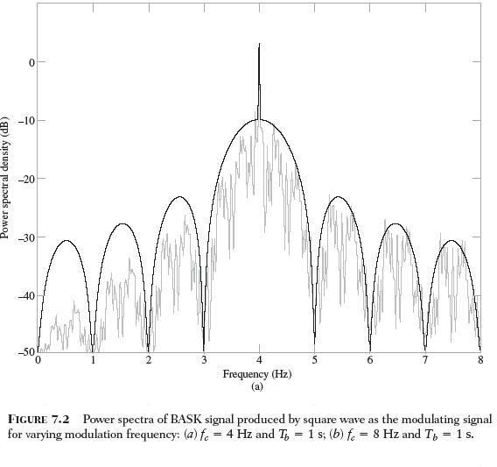

Slide 60
The spectrum of the BASK signal contains a line component at f=f_{c}
When the square wave is fixed and the carrier frequency is doubled, the mid-band frequency of the BASK signal is likewise doubled.
When the carrier is fixed and the bit duration is halved, the width of the main lobe of the sinc function defining the envelope of the BASK spectrum is doubled, which, in turn, means that the transmission bandwidth of the BASK signal is doubled.
The transmission bandwidth of BASK, measured in terms of the width of the main lobe of its spectrum, is equal to 2/T_{b}, where T_{b} is the bitduration.

Slide 61
Phase-Shift Keying
Binary Phase-Shift Keying (BPSK)
  The special case of double-sideband suppressed-carried (DSB-SC)
modulation
  The pair of signals used to represent symbols 1 and 0,
⎧ 2 E
⎪
^{b} cos( 2 π f t),
for symbol
1 correspond
ing to i = 1
T
c
s ( t ) = ⎪
b
( 7.12 )
i
⎨
⎪
⎪
2 E
2 E
^{b} cos( 2 π f t + π ) = −
^{b} cos( 2 π f t),
for symbol
0 correspond
ing to i = 2
⎩
T
c
T
c
b
b
An antipodal signals
  A pair of sinusoidal wave, which differ only in a relative phase-shift of π
radians.
The transmitted energy per bit, E_{b} is constant, equivalently, the average transmitted power is constant.
Demodulation of BPSK cannot be performed using envelope detection,
rather, we have to look to coherent detection as described next.

Slide 62
Generation and Coherent Detection of BPSK Signals
  Generation
A product modulator consisting of two component
  Non-return-to-zero level encoder
The input binary data sequence is encoded in polar form with symbols 1
and 0 represented by the constant-amplitude levels ; √E_{b} and - √E_{b},
2) Productmodulator
Multiplies the level-encoded binary wave by the sinusoidal carrier c(t) of
amplitude √2/T_{b} to produce the BPSK signal

Slide 63
2. Detection
A receiver that consists of four sections
  Product modulator; supplied with a locally generated reference signal
that is a replica of the carrier wave c(t)
  Low-pass filter; designed to remove the double-frequency components of the product modulator output
  Sampler ; uniformly samples the output of the low-pass filter, the local clock governing the operation of the sampler is synchronized with the clock responsible for bit-timing in the transmitter.
  Decision-making device ; compares the sampled value of the low-pass filter’s output to an externally supplied threshold. If the threshold is exceed, the device decides in favor of symbol 1, otherwise, it decides in favor of symbol 0.
What should the bandwidth of the filter be ?
The bandwidth of the low-pass filter in the coherent BPSK receiver has to be equal to or greater than the reciprocal of the bit duration T_{b} for satisfactory operation of the receiver.

Slide 64
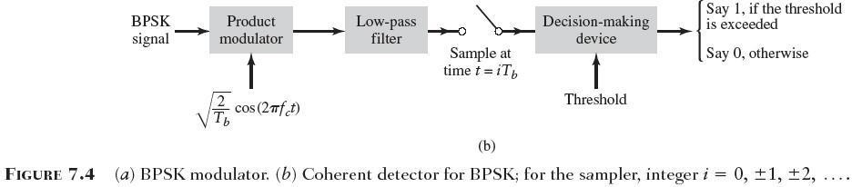

Slide 65
Spectral Analysis of BPSK
  The objectives
    To evaluate the effect of varying the carrier frequency fc on the power spectrum of the BPSK signal, for a fixed square modulating wave.
    To evaluate the effect of varying modulation frequency on the power spectrum of the BPSK signal, for a fixed carrier frequency.

Slide 66
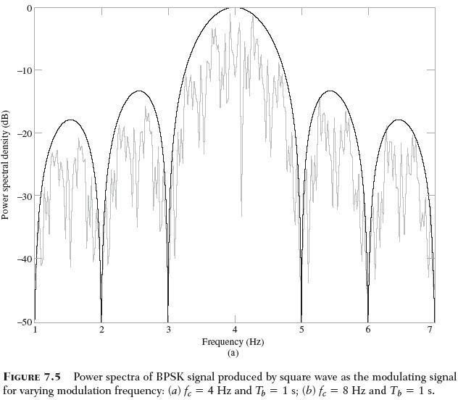

Slide 67
1. BASK and BPSK signals occupy the same transmission bandwidth, which defines the width of the main lobe of the sinc-shaped power spectra.
The BASK spectrum includes a carrier component, whereas this component is absent from the BPSK spectrum. With this observation we are merely restating the fact that BASK is an example of amplitude modulation, whereas BPSK is an example of double sideband-suppressed carrier modulation
  The present of carrier in the BASK spectrum means that the binary data stream can be recovered by envelope detection of the BASK signal.
  On the other hand, suppression of the carrier in the BPSK spectrum mandates the use of coherent detection for recovery of the binary data stream form the BASK signal

Slide 68
Quadriphase-Shift Keying
  An important goal of digital communication is the efficient utilization of channel bandwidth
  In QPSK (Quadriphase-shift keying)
    The phase of the sinusoidal carrier takes on one of the four equally
spaced va⎧lue₂s,_{E}suchas π/4, 3π/4, 5π/_{π}4, and 7π/4
⎡ ⎤
⎪
cos ⎢ 2 π f t + ( 2 i − 1) _{4 ⎥} , 0 ≤ t ≤ T
s ( t ) = ⎨
T
⎣
c
⎦
( 7 .13 )
i
⎪⎩0 ,
elsewhere
Each one of the four equally spaced phase values corresponds to a unique
pair of bits called dibit
T = 2 T ( 7 .14 )
b
2 E
π ⎤
cos ⎢( 2 i − 1)
2 E
π ⎤
sin ⎢( 2 i − 1)
s ( t ) =
i
⎡
_{4 ⎥}cos( 2 π f t ) −
⎡
_{4 ⎥}sin( 2 π f t )
( 7 .15 )
T
⎣
⎦
c
T
⎣
⎦
c

Slide 69
1. In reality, the QPSK signal consists of the sum of two BPSK signals
2. One BPSK signal, represented by the first term defined the product of
modulating a binary wave by the sinusoidal carrier
this binary wave has an amplitude equal to ±√E/2
⎡
π ⎤
2 E / T cos ( 2 i − 1)
cos( 2 π f t ),
⎢
4
⎥
c
⎣
⎦
⎡
π ⎤
⎧
⎨
⎩
E / 2
for i = 1 , 4
i = 2 , 3
E cos ( 2i − 1)
=
( 7 .16 )
⎢
4
⎥
⎣ ⎦
E / 2 for
3. The second binary wave also has an amplitude equal to ±√E/2
⎡
π ⎤
− 2 E / T sin ( 2 i − 1) sin( 2 π f t ),
⎢ ⎥
c
⎣
4
⎦
⎡
π ⎤
⎧ − E / 2 for i = 1 , 2
⎨
⎦ ⎩ E / 2 for i = 3 , 4
E sin ( 2i − 1)
=
( 7.17 )
⎢
4
⎥
⎣

Slide 70
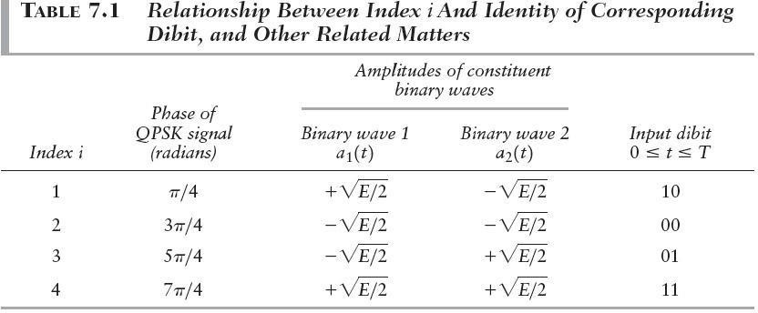

Slide 71
Generation and Coherent Detection of QPSK Signals
  Generation
The incoming binary data stream is first converted into polar form by a non-return-to-zero level encoder
The resulting binary wave is next divided by means of a demultiplexer into two separate binary waves consisting of the odd- and even- mumbered input bits of b(t) – these are referred to as the demultiplexed components of the input binary wave.
The two BPSK signals are subtracted to produce the desired QPSK signals

Slide 72
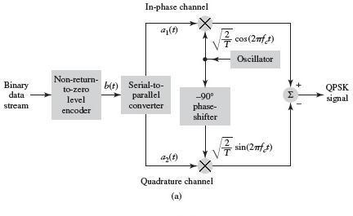

Slide 73
2. Detection
The QPSK receiver consists of an In-phase and quadrature with a
common input.
Each channel is made up of a product modulator, low-pass filter,
sampler, and decision-making device.
The I- and Q-channles of the receiver, recover the demultiplexed components a₁(t) and a₂(t)
By applying the outputs of these two channels to a multiplexer,
the receiver recovers the original binary sequence
Each of the two low-pass filters must be assigned a bandwidth
equal to or greater than the reciprocal of the symbol duration T

Slide 74
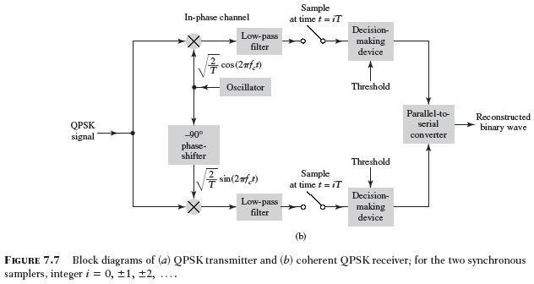

Slide 75
Offset Quadriphase-Shift Keying (OQPSK)
  The extent of amplitude fluctuations exhibited by QPSK signals may be reduced by using a variant of quadriphase-shift keying
  The demultiplexed binary wave labeled a₂(t) is delayed by one bit duration with respect to the other demultiplexed binary wave labled a₁(t)
  ±90◦ phase transitions occur twice as frequency but with a reduced range of amplitude fluctuations.
  Amplitude fluctuations in OQPSK due to filtering have a smaller amplitude than in QPSK.

Slide 76
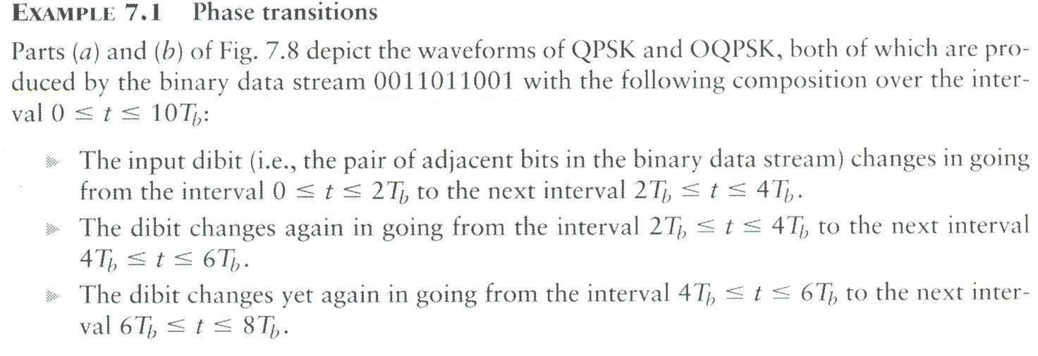
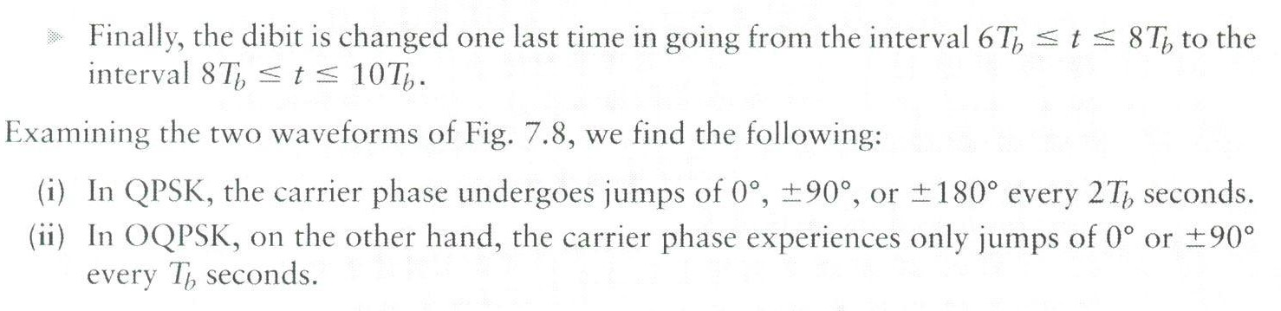

Slide 77
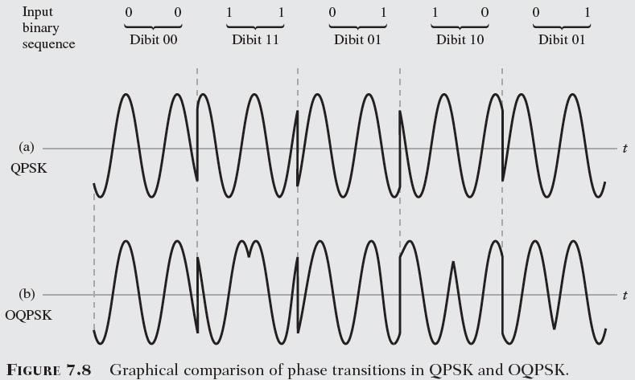

Slide 78
Computer Experiment III : QPSK and OPQSK Spectra
– QPSK Spectra
Carrier
Frequency,
f _{c} = 8 Hz
⎧ 1s for part
⎩ 0 s for part
(a) of
the figure
⎫
⎬
⎭
Bit duration, T_{b} = ⎨
(b) of
the figure
OQPSK Spectra
  For the same parameters used for QPSK
– QPSK occupies a bandwidth equal to one half that of BPSK

Slide 79
Frequency-Shift Keying
Binary Frequency-Shift Keying (BFSK)
– Each symbols are distinguished from each other by transmitting one of two
sinusoidal waves that differ in frequency by a fixed amount
⎧ 2 E
⎪
^{b} cos( 2 π f t),
for symbol
1 correspond
ing to i = 1
T
b
1
s ( t ) = ⎪
⎨
⎪
⎪ T
( 7 .18 )
i
2 E
^{b} cos( 2 π f t ),
for symbol
0 correspond
ing to i = 2
⎩
2
b
Sunde’s BFSK
  When the frequencies f₁ and f₂ are chosen in such a way that they differ from
each other by an amount equal to the reciprocal of the bit duration T_{b}

Slide 80
Computer Experiment IV : Sunde’s BFSK
  Waveform
Input binary sequence 0011011001 for a bit duration T_{b}=1s
The latter part of the figure clearly displays the phase- continuous property of Sunde’s BFSK
2. Spectrum
Bit duration, T = 1 s
b
Carrier frequency, f = 8 Hz
c
The spectrum contains two line components at the frequency f=f_{c}±1(2T_{b}); which equal 7.5Hz and 8.5Hz for f_{c}=8 Hz and T_{b}=1s
The main lobe occupies a band of width equal to (3/T_{b})=3Hz, centered on the carrier
frequency f_{c}=8 Hz
The largest sidelobe is about 21 dB below the main lobe.

Slide 81
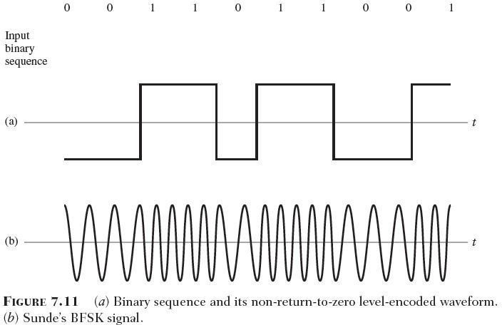

Slide 82
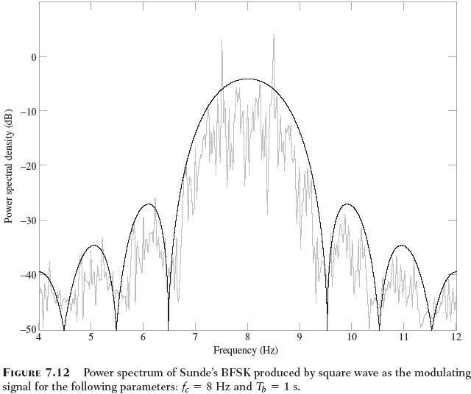

Slide 83
Continuous-phase Frequency-Shift Keying
  The modulated wave maintains phase continuity at all transition points, even though at those points in time the incoming binary data stream switches back and forth
  Sunde’s BFSK, the overall excursion δf in the transmitted frequency from symbol 0 to symbol 1, is equal to the bit rate of the incoming data stream.
  MSK (Minimum Shift Keying)
    The special form of CPFSK
    Uses a different value for the frequency excursion δf , with the result that this
new modulated wave offers superior spectral properties to Sunde’s BFSK.

Slide 84
Minimum-Shift Keying
– Overall frequency excursion δf from binary symbol 1 to symbol 0, is one half
the bit rate
δ f = f − f
1
1
2
=
( 7.19 )
2T
1
b
f = ( f +
f ) ( 7.20 )
c 1
2
2
δf
f = f +
, for symbol
1 ( 7 .21 )
1
c
2
δf
2
f =
f −
, for symbol
0 ( 7 .22 )
2
c
– Define the MSK signal as the angle-modulated wave
2 E
s ( t ) = ^{b} cos[ 2 π f t + θ ( t )]
( 7 .23 )
T
c
b

Slide 85
– Sunde’s BFSK has no memory; in other words, knowing which particular change occurred in the previous bit interval provides no help in the current bit interval.
θ ( t ) = 2 π ^{⎛ δ f ⎞}t
⎜ ⎟
⎝ 2 ⎠
πt
=
,
for symbol 1 ( 7.24 )
2T
b
θ ( t ) = 2 π ⎛ − ^{δ f ⎞} t
⎜ ⎟
⎝
2 ⎠
πt
= −
,
for symbol 0 (7 .25 )
2T
b

Slide 86
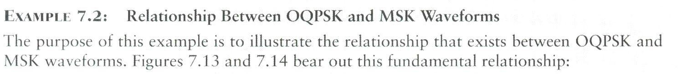
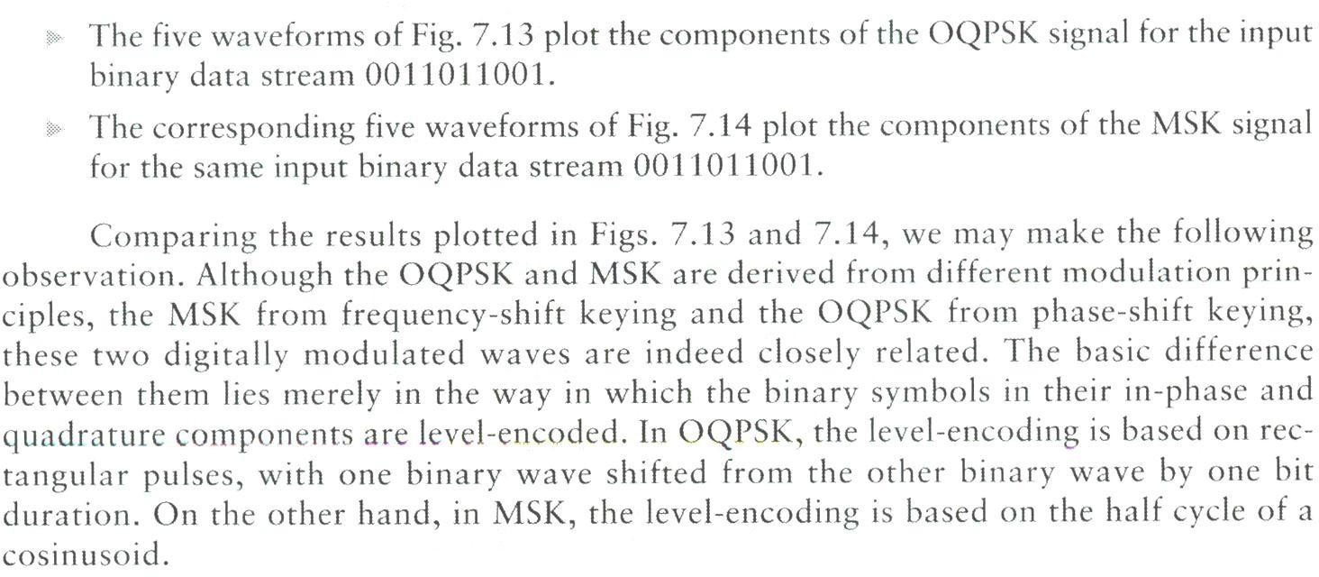

Slide 87
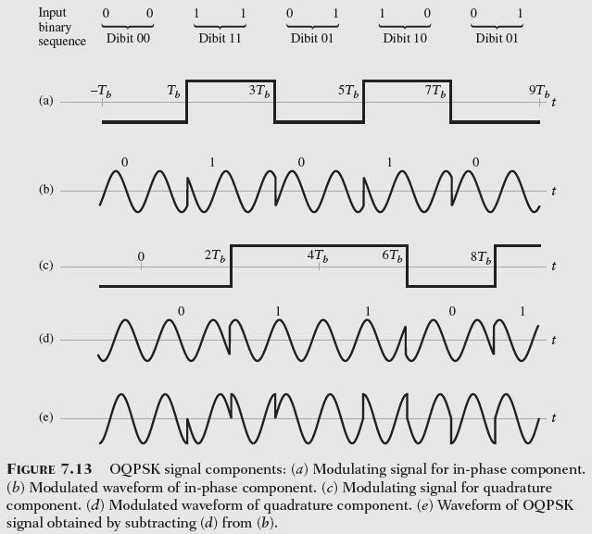

Slide 88
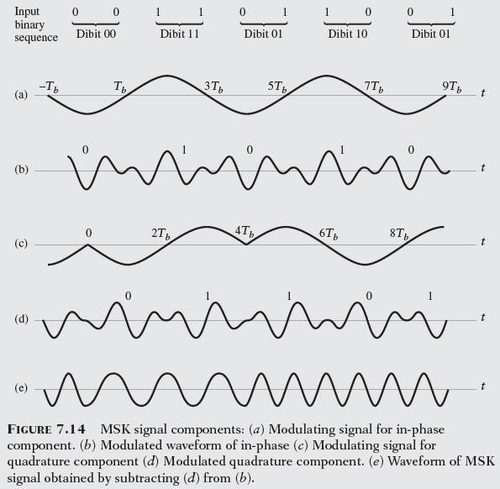

Slide 89
Formulation of Minimum-Shift Keying
2 E
2 E
s ( t ) = ^{b} cos( θ ( t )) cos( 2 π f t ) −
^{b} sin( θ ( t )) sin( 2 π f t)
( 7.26 )
T
c
T
c
b
b
( i ) s ( t ) = E cos( θ ( t )) is the
I b
in - phase ( I ) component
associated
with the
carrier
2 / T cos( 2 π f t ).
b c
( 7.27 )
(ii ) s ( t ) =
E sin( θ ( t )) is the
quadrature
( Q ) component
associated
with the 90 ° -
Q b
phase - shifted carrier.
( 7 .28 )
₋ ₁ ⎡ s _{Q} ( t ) ⎤
s ( t ) = a ( t ) cos( 2 π f t )
I 1 0
( 7.29 )
θ ( t ) = − tan
⎢ s ( t ) ⎥
⎣ ⎦
− 1 ^{⎡ a}
I
(t )
⎤
⎥
⎦
s (t ) = a (t ) sin( 2π f t )
Q 2 0
( 7 .30 )
= − tan
⎢
2
tan( 2 π f t )
( 7 .31 )
⎣ a ( t)
0
1

Slide 90
1. a₂(t)=a₁(t)
This scenario arises when two successive binary symbols in the incoming data stream are the same
θ ( t ) = − tan ⁻¹ [tan( 2 π f t )]
0
= − 2 π f t
0
( 7.32 )
2. a₂(t)=-a₁(t)
This second scenario arises when two successive binary symbols in the
incoming data stream are different
θ ( t ) = − tan ⁻ ¹ [ − tan( 2 π f t )]
0
= 2 π f t
0
( 7 . 33 )
1
f =
( 7 .34 )
0
4T
b

Slide 91
Given a non-return-to-zero level encoded binary wave b(t) of prescribed bit duration T_{b} and a sinusoidal carrier wave of frequency f_{c}, we may formulate the MSK signal by proceeding as follows
  Use the given binary wave b(t) to construct the binary demultiplexed-
offset waves a₁(t) and a₂(t)
  Use Eq. (7.34) to determine the frequency f₀
  Use Eq. (7.29) and (7.30) to determine the in-phase component s_{I}(t) and quadrature component s_{Q}(t), respectively from which the MSK signal s(t) follows

Slide 92
Computer Experinment V : MSK Spectrum
– The parameters
Bit duration, T _{b} = 1 s
Carrier frequency, f _{c} = 8 Hz
MSK versus QPSK
  The main lobe of MSK occupies a frequency band whose width is 1.5/T_{b}=1.5Hz
  The transmission bandwidth of MSK is 50 percent larger than that of QPSK
  The sidelobes of MSK are considerably smaller than those of QPSK
MSK versus Sunde’s BFSK
  The transmission bandwidth of MSK is one half that of Sunde’s BFSK
  Sunde’s BFSK exhibits two line components at f=f_{c}±1/(2T_{b})
  The spectrum of MSK is continuous across the whole frequencyband

Slide 93
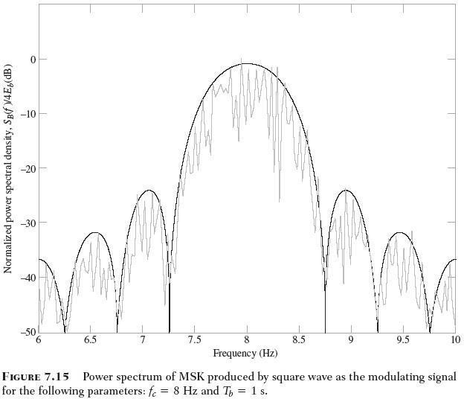

Slide 94
Although the carrier frequency is not high enough to completely eliminate spectral overlap, the overlap is relatively small as evidenced by
  The small value of the spectrum at zero frequency
  The small degree of asymmetry about the carrier frequency f_{c}=8Hz

Slide 95
Summary of Three Binary Signaling Schemes
BASK, BPSK, and BFSK are the digital counterparts of amplitude modulation, phase modulation, and frequency modulation
Both BASK and BPSK exhibit discontinuity. It is possible to configure BFSK in such a way that phase continuity is maintained across the entire input binary data stream. The BFSK waveform plotted in part (d) of the figure is an example of minimum-shift keying
Table 7.2 presents a summary of the three binary modulation schemes

Slide 96
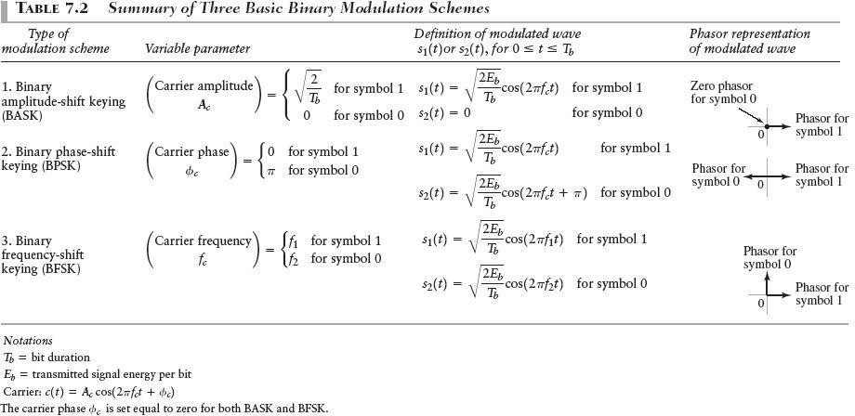

Slide 97
Non-coherent Digital Modulations Schemes
Both BASK and BPSK are examples of linear modulation, with increasing complexity in going from BASK and BPSK.
BFSK is in general an example of nonlinear modulation
Noncoherent Detection of BASK Signal
  The system designer would have knowledge of two system parameters
    The carrier frequency f_{c}
    The transmission bandwidth, which is determined by the bit duration T_{b}.
  The band-pass filter is designed to have a mid-band frequency equal to the carrier frequency f_{c} and a bandwidth equal to the transmission bandwidth of the BASK signal.
  The rise time and decay time of the response of the filter to a rectangular
pulse be short compared to the bit duration T_{b}
Band-pass filter produces a pulsed sinusoid for symbol 1, no output for symbol 0.
Envelope detector traces the envelope of the filtered version of the BASK
signal.
Decision-making device working in conjunction with the sampler, regenerates the original binary data stream

Slide 98
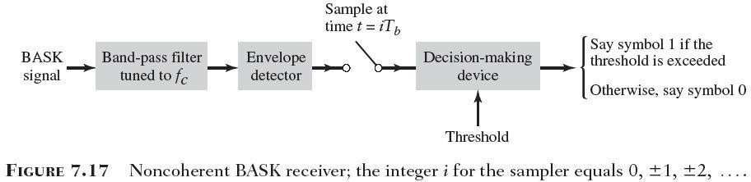

Slide 99
Noncoherent Detection of BFSK Signals
  The receiver consists of two paths
    Path 1 : uses a band-pass filter of mid-band frequency f₁. produce the output v₁
    Path 2 : uses a band-pass filter of mid-band frequency f₂. produce the output v₂
  The output of the two paths are applied to a comparator

Slide 100
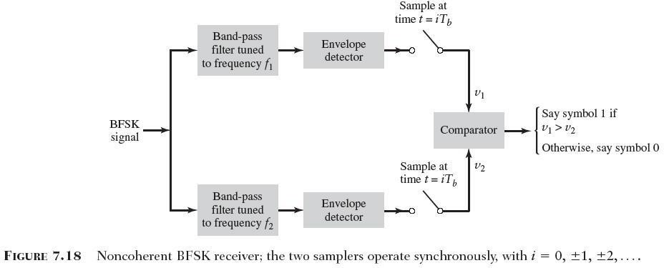

Slide 101
Differential Phase-Shift Keying
  In the case of phase-shift keying, we cannot have noncoherent detection in the traditional sense because the term “noncoherent” means having t to without carrier-phase information
  We employ a “pseudo PSK” technique (differential phase-shift keying)
  DPSK eliminates the need for a coherent reference signal at the
receiver by combination two basic operations at the transmitter
    Differential encoding of the input binary wave
    Phase-shift keying
  The receiver is equipped with a storage capability designed to measure the relative phase difference between the waveforms received during two successive bit intervals.
  The phase difference between waveforms received in two succssive bit
intervals will be essentially independent of θ.

Slide 102
1. Generation
The differential encoding process at the transmitter input starts with an arbitrary first bit, serving merely as reference
  If the incoming binary symbol b_{k} is 1, then the symbol d_{k} is unchanged with respect to the previous symbol d_{k-1}
  If the incoming binary symbol b_{k} is 0, then the symbol d_{k} is changed with respect to the
previous symbol d_{k-1}
2. Detection
The phase-modulated pulses pertaining to two successive bits
are identical except for a possible sign reversal
The incoming pulse is multiplied by the preceding pulse
The preceding pulse serves the purpose of a locally generated reference signal
Applying the sampled output of the low-pass filter to a decision-
making device supplied with a prescribed threshold, detection
of the DPSK signal is accomplished.

Slide 103
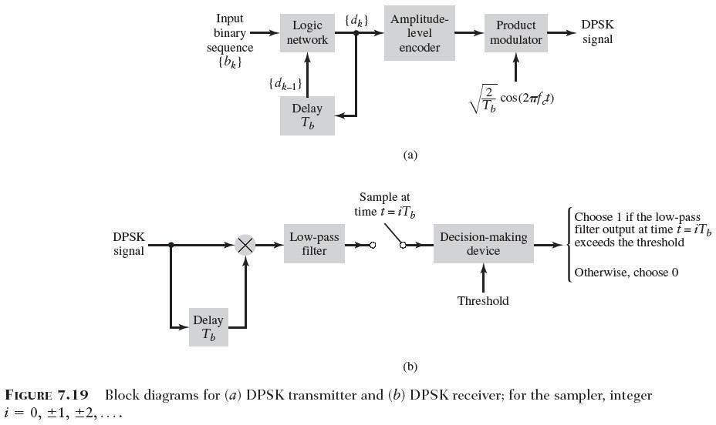

Slide 104
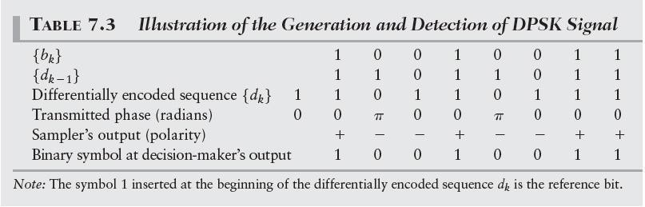

Slide 105
M-ary Digital Modulation Schemes
we send any one of M possible signals during each
signaling interval of duration T
The requirement is to conserve bandwidth at the expense
of both increased power and increased system complexity
When the bandwidth of the channel is less than the required value, we resort to an M-ary modulation scheme for maximum bandwidth conservation
M-ary Phase-Shift Keying
  If we take blocks of m bits to produce a symbol and use an M-ary PSK scheme with M=2^{m} and symbol duration T=mT_{b}
  The bandwidth required is proportional to 1/(mT_{b})
  The use of M-ary PSK provides a reduction in transmission
bandwidth by a factor by a factor m=log₂M

Slide 106
– The discrete coefficients are respectively referred to as the in-phase and quadrature components of the M-ary PSK singal
2 E
⎛
2π
⎞
i = 0,1,..., M − 1
0 ≤ t ≤ T
s ( t ) =
i
cos ⎜ 2 π f _{c} t +
⎝
i ⎟,
⎠
( 7 .35 )
T
M
s ( t ) = ⎡ E cos ⎜^{⎛ 2 π} i ⎟⎞ ⎤ ⎡
2 ⎤
cos( 2 π f t )
⎢ ⎥
⎣
⎥
i
⎝ M
T
c
⎠ ⎦ ⎢
⎣
⎦
₋ ⎡
² sin( 2 π f t ) ⎤ ,
i = 0,1,..., M − 1
0 ≤ t ≤ T
E sin ⎛⎜^{2 π} i ⎞ ⎤⎟ ⎡ ⎢
( 7 .36 )
⎢
⎝ M
⎥
⎠
c
⎥
⎦
⎣
⎦⎣
T
2
⎞⎤
2 ⎫
⎞⎤
1 / 2
⎧ ⎡
⎛ 2 π
⎡
⎛ 2 π
E cos ⎜
i ⎟⎥ + ⎢ E sin ⎜
i ⎟⎥
⎬
⎭
= E , for all i
( 7 .37 )
⎨ ⎢
⎝ M
⎩ ⎣
⎝ M
⎠⎦ ⎣
⎠⎦

Slide 107
Signal-Space Diagram
– Pair of orthogonal functions
2
φ ( t ) = cos( 2 π f t ),
0 ≤ t ≤ T
( 7 .38 )
1
T
2
c
φ ( t ) =
sin( 2 π f t ),
0 ≤ t ≤ T
( 7 .39 )
2
T
c
M-ary PSK is described in geometric terms by a constellation of M signal points
distributed uniformly on a circle of radius √E
Each signal point in the figure corresponds to the signal s_{i}(t) of Eq. (7.35) for a
particular value of the index i.
The squared length from the origin to each signal point is equal to thesignal energy E.

Slide 108
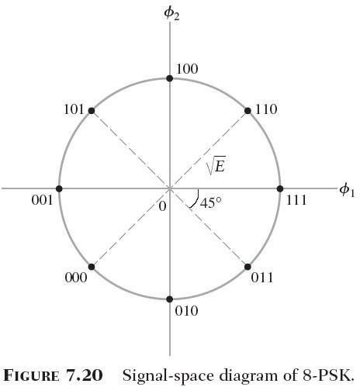

Slide 109
M-ary Quadrature Amplitude Modulation (QAM)
– The mathematical description of the new modulated signal
2 E
0 _{a}
T
2 E
i = 0 ,1,..., M − 1
0 ≤ t ≤ T
s ( t ) =
cos( 2 π f t ) − ⁰ b sin( 2 π f t),
( 7.40 )
i
i
c i
c
T
The level parameter for in-phase component and quadrature component are independent of each other for all I
M-ary QAM is a hybrid form of M-ary modulation
M-ary amplitude-shift keying (M-ary ASK)
If b_{i}=0 for all i, the modulated signal s_{i}(t) of Eq. (7.40) reduces to
2 E
s ( t ) = ⁰ a cos( 2 π f t )
i = 0 ,1,..., M − 1
i
– M-ary PSK
T
i
c
If E0=E and the constraint is satisfied
_{+ Eb} 2 ₎1 / 2
i
( Ea ²
i
= E , for all i

Slide 110
Signal-Space Diagram
  the signal-space representation of M-ary QAM for M=16
  Unlike M-ary PSK, the different signal points of M- ary QAM are characterized by different energy levels
  Each signal point in the constellation corresponds to a specific quadbit

Slide 111
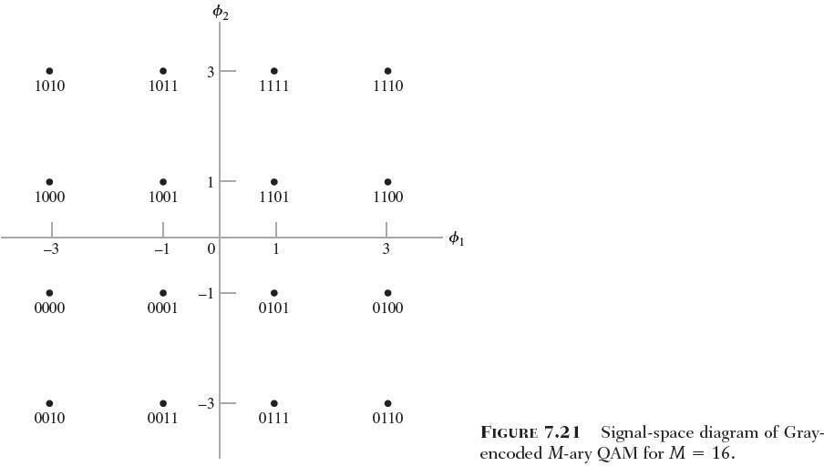

Slide 112
M-ary Frequency-Shift Keying
– In one form of M-ary FSK, the transmitted signals are defined for some
fixed integer n as
2 E ⎡π ⎤
cos _{⎢⎣T} ( n + i ) t ,
i = 0,1,..., M − 1
0 ≤ t ≤ T
s ( t ) =
i
⎥⎦
( 7 .41 )
T
– Like M-ary PSK, the envelope of M-ary FSK is constant for all M
T
⎧ E for i = j
∫
s ( t ) s ( t )dt =
⎨
0 for i ≠ j
( 7.42 )
0
i
j
⎩
Signal-Space Diagram
  Unlike M-ary PSK and M-ary QAM, M-ary FSK is described by an M- dimensional signal-space diagram
1
i = 0 ,1,..., M − 1
0 ≤ t ≤ T
φ ( t ) =
s ( t )
( 7 .43 )
i
E
i

Slide 113
1. Correlating the signal
2 E
s (t ) =
^{b} cos( 2 π f t )
for symbol
1 (7 .45 )
1
T
c
b
s = ∫ ^{b} φ ( t ) s ( t ) dt
T
1 1 1
0
= ∫
T
b
2
E cos ² ( 2 π f t )dt
b c
( 7.46 )
0
T
b
s = E ( 7 .47 )
1 b
under the band-pass assumption,
2 E
s ( t ) = − ^{b} cos( 2 π f t )
for symbol
0 (7 .48 )
2 c
T
s = − E
b
( 7 .49 )
2 b
2. We may show that the signal

Slide 114
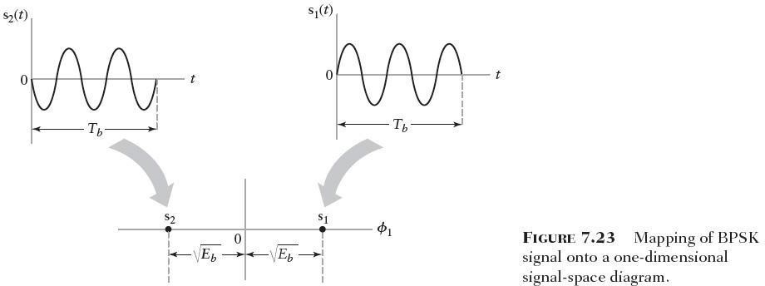

Slide 115
– As with BPSK, the signal-space diagram consists of two transmitted signal points
⎡
⎢
⎣
E ⎤ ⎡
0
⎤
⎥
s =
b
( 7 .50 )
s =
( 7 .51 )
1
⎥
⎦
2 ⎢
⎣ b ⎦
0
E
– Fig. 7.23 and 7.24 differ in one important respect : dimensionality
2
2
φ ( t ) =
2
cos( 2 π f t )
2
φ ( t ) = cos( 2 π f t )
( 7.52 )
( 7 .53 )
1 1
T
T
b
b
The separation between the transmitted signal points for BPSK is √2 times that for BFSK
The received signal point lies inside a “cloud” centered on the transmitted signal point

Slide 116
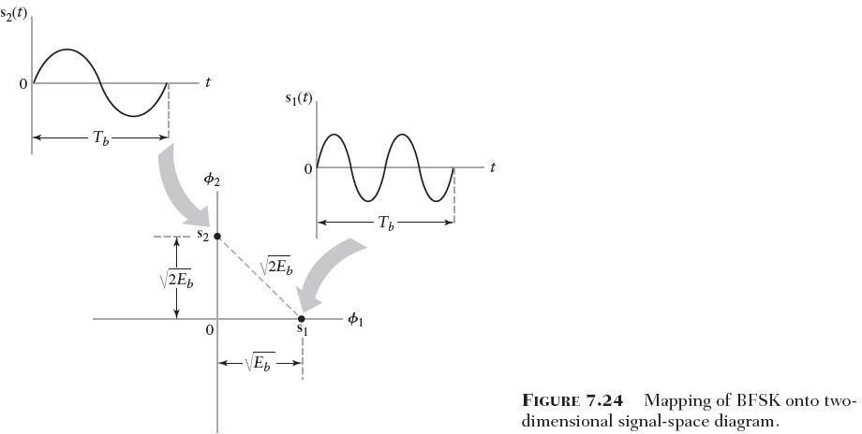

Slide 117
Digital Baseband Transmission
Why to apply digital transmission?
Symbols and bits
Baseband transmission
  Binary error probabilities in baseband transmission
Pulse shaping
  minimizing ISI and making bandwidth adaptation - cos roll-
off signaling
  maximizing SNR at the instant of sampling - matched
filtering
  optimal terminal filters
Determination of transmission bandwidth as a function of pulse shape
  Spectral density of Pulse Amplitude Modulation (PAM)
Equalization - removing residual ISI - eye diagram

Slide 118
Why to Apply Digital Transmission?
Digital communication withstands channel noise, interference
and distortion better than analog system. For instance in PSTN
inter-exchange STP*-links NEXT (Near-End Cross-Talk) produces
several interference. For analog systems interference must be
below 50 dB whereas in digital system 20 dB is enough. With this respect digital systems can utilize lower quality cabling than analog systems
Regenerative repeaters are efficient. Note that cleaning of analog-signals by repeaters does not work as well
Digital HW/SW implementation is straightforward
Circuits can be easily reconfigured and preprogrammed by DSP
techniques (an application: software radio)
Digital signals can be coded to yield very low error rates
Digital communication enables efficient exchanging of SNR to
BW-> easy adaptation into different channels
The cost of digital HW continues to halve every two or three
years
STP: Shielded twisted pair

Slide 119
Symbols and Bits
D (s ym b o l ra te r = 1 / D baud )
T ( b it ra te r = 1 / T bi ts /s )
b b
n = lo g M
2
b
 | 1 | 1 | 0 | 1 | 1 | 0 | 0 | 0 | 1 | 1 | 1 | 1
s ( t )
M = 2^{n}
Generally: s ( t ) = ∑ a
p ( t − k D ) (a PAM* signal)
⎧ n : n u m b e r o f b it s
⎪ M : n u m b e r o f le v e ls
⎨
⎪ D : S y m b o l d u ra tio n
k
k
⎪
For M=2 (binary signalling): s ( t ) = ∑ a
k
p ( t − k T )
k
b
For non-Inter-Symbolic Interference (ISI), p(t) must
⎪⎩T
satisfy:
: B it d u a ra tio n
⎧1, t = 0
p ( t ) = ⎨
⎩ 0 , t = ± D , ± 2 D ...
unipolar,
2-level pulses
b
This means that at the instant of decision
s ( t ) = ∑ a p ( t − k D ) = a
k
k
k
*Pulse Amplitude Modulation

Slide 120











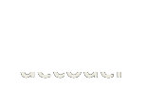
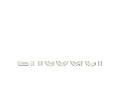
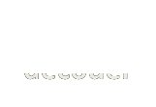










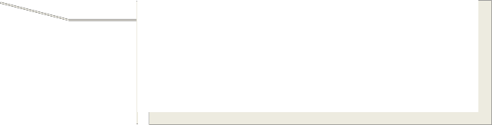




Digital Transmissi on
Transmitted power; bandpass/baseband signal BW
Information:
-analog:BW & dynamic range
-digital:bit rate
Information source
Message
Message
estimate
Information sink
Maximization of information transferred
Source
encoder
Source
decoder
Channel
Encoder
Channel
decoder
In baseband systems
these blocks are missing
Message protection & channel adaptation; convolution, block coding
Interleaving
Deinterleaving
Modulator
Demodulator
Fights against burst
errors
Transmitted
signal
Channel
Received signal
(may contain errors)
M-PSK/FSK/ASK...,
depends on channel
BW & characteristics
wireline/wireless constant/variable linear/nonlinear
Noise
Interference
‘Baseband’ means that no carrier wave modulation is used for transmission

Slide 121
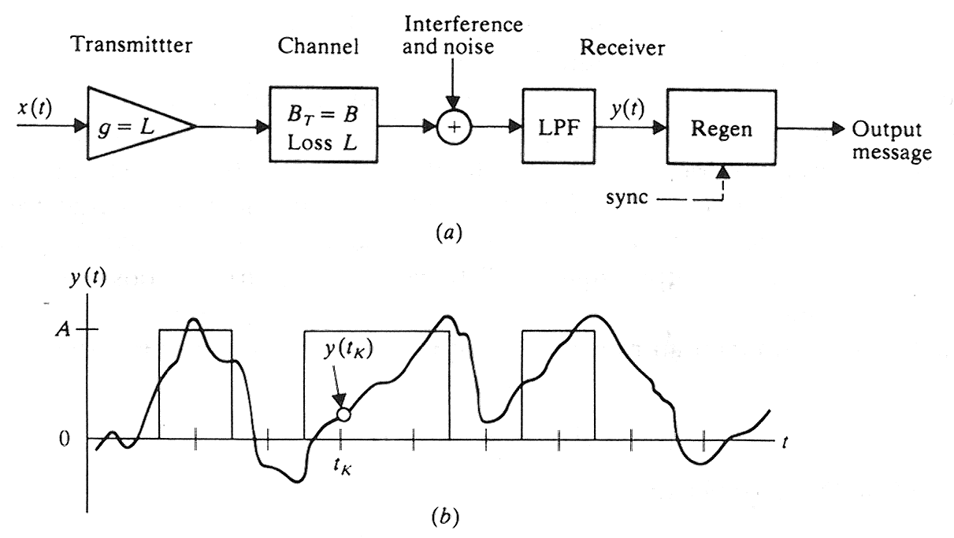
Baseband Digital Transmission Link
t
D
Unipolar PAM
original message bits
received wave y(t)
y ( t ) = ∑ a p ( t − t
k
k D ) + n ( t)
decision instances
k
d
message reconstruction at t
= K D + t
yields
K
d
y ( t ) = a
∑ a
k ≠ K
p ( K D − k D ) + n ( t )
K
k
k
message
ISI
Gaussian bandpass noise

Slide 122
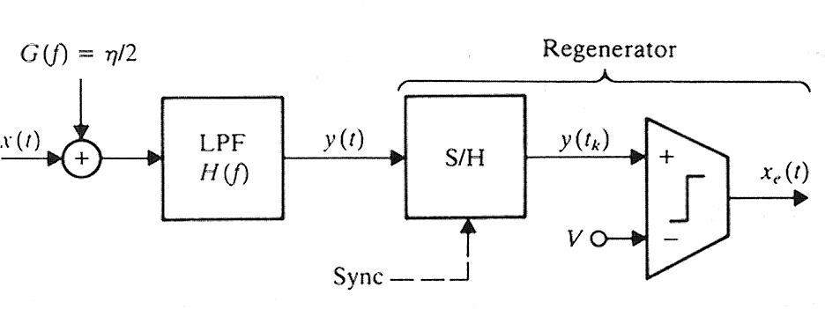
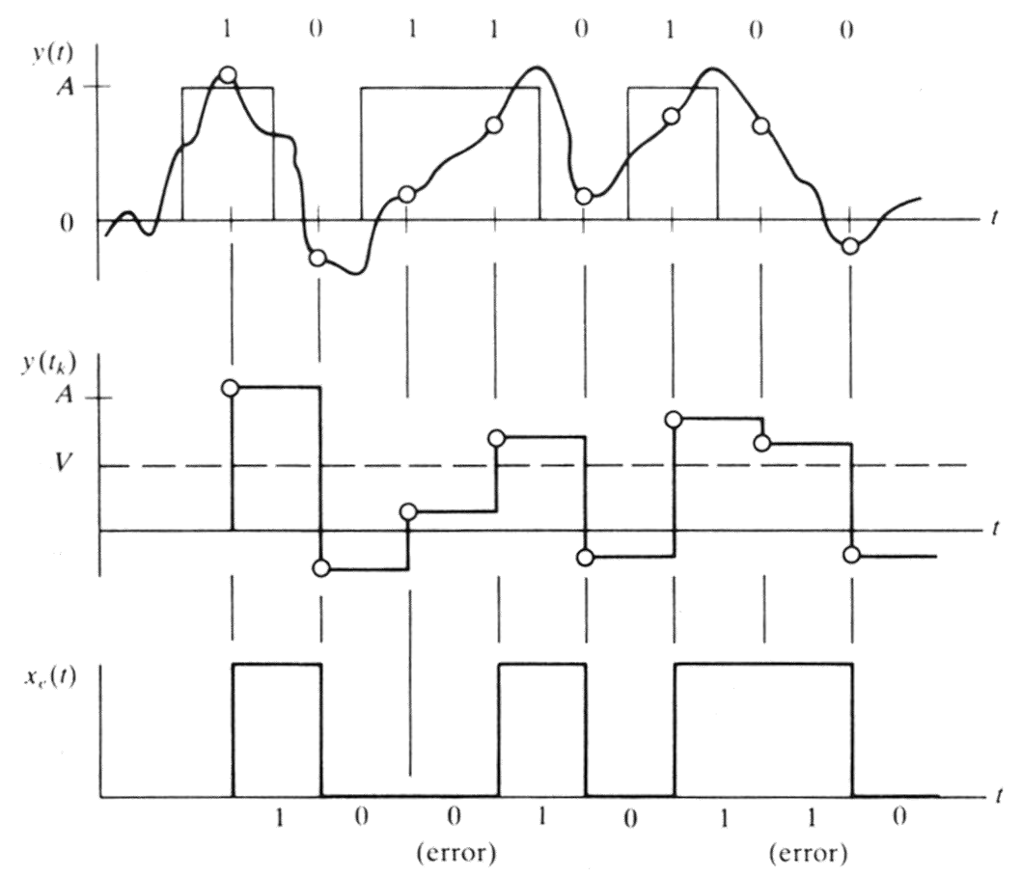
Baseband Unipolar Binary Error Probability
Assume binary & unipolar x(t)
The sample-and-hold circuit yields:
r .v . Y : y ( t ) = a + n ( t )
k k k
Establish H₀ and H₁ hypothesis:
H : a = 0, Y = n
k
0
p ( y | H ) = p ( y )
0 N
Y
and
H : a = 1, Y = A + n
1 k
p ( y − A)
N
p ( y | H ) =
Y 1
p_{N}(y): Noise spectral density

Slide 123
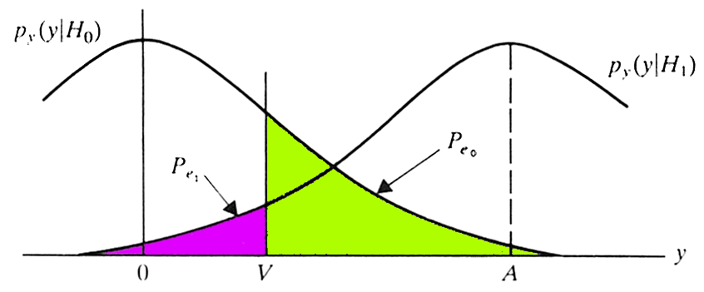

Determining Decision Threshold
H : a = 0, Y = n
0 k
p ( y | H ) = p ( y )
Y 0 N
H : a = 1, Y = A + n
1 k
p ( y − A )
N
p ( y | H ) =
Y 1
The comparator implements decision rule:
Choose Ho (a =0) if Y<V
k
Choose H1 (a_{k}=1) if Y>V
p | e 1 | ≡ | P (Y | < | V | | | H | 1 | V ) = ∫_{− ∞} |  | p ( y | H Y | 1 | )d y
p | eo | ≡ | P (Y | > | V | | | H | 0 | ) = ∫ | ∞ V | p ( y | H Y | 0 | )d y
Average error error probability: P
= P P + P P
Transmitted „0‟
but detected as „1‟
e
0 e 0
1 e1
P = P = 1 / 2 ⇒ P = ( P + P )
1
2
0 1 e e 0
e 1
Assume Gaussian noise:
p ( x ) =
N
_{x} 2
⎞
⎠
1
⎛
e x p⎜ −
₂ ⎟
ο 2 π
⎝
2 σ

Slide 124


Determining Error Rate
∞
p = ∫ p
( y )dy
e 0 V
N
_{x} 2
1
p = ∫ ∞ e x p ⎛ − ⎞ d x
e V
⎜
⎝
⎟
2 ⎠
0
ο 2π
2σ
that can be expressed by using the Q-function, defined by
1
_{λ} 2 ⎞
∞
⎛
Q ( k ) = _{∫k} e x p ⎜ − ⎟d λ ⇒
2π
2
⎝ ⎠
1
⎛
_{x} 2
V
ο p = e xp −
⎞ d x = σ Q ⎛ ⎞
∫
∞
⎜
⎝
₂ ⎟
⎜ _{σ} ⎟
e 0
2π
V
2σ
⎠
⎝ ⎠
and therefore
p = Q ^{⎛ V}
⎞
⎛ A − V ⎞
⎜ _{σ} ⎟ and also P_{e 1}
V
p ( y − A )d y = Q
N ⎜
e 0
⁼ ∫− ∞
σ
⎟
⎠
⎝ ⎠
⎝

Slide 125
Baseband Binary Error Rate in Terms of Pulse Shape and γ
setting V=A/2 yields then
A
⎞
p = ( p + p
) = p = p ⇒
e 1
p = Q ⎛
1
2
⎜ ⎟
e e 0
e1
e 0
e
⎝ 2 σ ⎠
for unipolar, rectangular NRZ [0,A] bits
S = x ² + σ = A ² / 2
2
R D C
for polar, rectangular NRZ [-A/2,A/2] bits
S = x ² + σ
R D C
2
= A ² / 4
A / 2
T / 2
2 ⎛ A ⎞
2
2
_{A} 2
∫ ⎜ ⎟
2T
⎛ A ⎞
a ² =
=
⎜ ⎟
=
= 0
and hence
2
k
T
⎝ ² ⎠
2T
⎝ 2
⎠
4
− A / 2
0
A
_{A} 2
⎧ S /( 2 N ), u n ip o la r
= ⎨
⎛ ⎞
R
⎩ S / N , p o la r
⎜
=
R
⎝ 2 σ ⎟
4 N
⎠
R
R
R
⎧γ
= E / N = S
b 0
/ N r
0 b
⎧ 2 γ
N r /( 2 N r ) = γ , u n ip o la r
⎨
b
R
⇒ ⎨
b 0 b 0 b b
⎩ ^{N} R
= N r / 2
⎩ 2 γ _{b} N ₀ r_{b} / N ₀ r_{b} = 2 γ _{b} , p o la r
0 b
Note that N = N
R
B ≥ N r / 2 (lower limit with sinc-pulses (see later))
0 N 0 b

Slide 126

Pulse Shaping and Band-limited Transmission
In digital transmission signaling pulse shape is chosen to satisfy the following requirements:
  yields maximum SNR at the time instance of decision
(matched filtering)
  accommodates signal to channel bandwidth:
    rapid decrease of pulse energy outside the main lobe in
frequency domain alleviates filter design
    lowers cross-talk in multiplexed systems

Slide 127


Signaling With Cosine Roll-off Signals
Maximum transmission rate can be obtained with sinc-pulses
⎧ p ( t ) = s i n c ( r t ) = s in c ( t / D )
⎪
⎨ 1
⎛ f ⎞
⎪ P ( f ) = F [ p ( t ) ] = Π ⎜
⎟
⎩
r
⎝ r ⎠
However, they are not time-limited. A more practical choice is the
cosine roll-off signaling:
for raised cos-pulses β=r/2
π f
2 r
1
c o s 2πβ t
P ( f )
= co s ²
r
Π ( f / 2 r )
p ( t) =
s in c r t
β = r / 2
1 − ( 4 β t ) ²

Slide 128

Example
By using β = r / 2
is obtained:
and polar signaling, the following waveform
Note that the zero crossing are spaced by D at
t = ± 0 .5 D , ± 1 .5 D , ± 2 .5 D , ....
(this could be seen easily also in eye-diagram)
The zero crossing are easy to detect for clock recovery. Note that unipolar baseband signaling involves performance penalty of 3 dB compared to polar signaling:
₌ ⎧⎪ Q ( γ _{b} ), u n ip o la r [ 0 / 1 ]
p
⎨
e
⎪ Q ( 2γ ), p o la r [ ± 1 ]
⎩
b

Slide 129


Matched Filtering
⎧ x ( t ) = A p ( t − t )
G ( f )
n
⎨
R R 0
y (t )
⎩ X ( f ) = A P ( f ) e x p ( − jω t )
x ( t )
R
H(f)
D
R R
0
+
∞ E = ∫ R | X ( f ) R | 2 d f = A ² R | ∞ ∫
− ∞ |  |  | − ∞
2
P ( f ) df
A = F ⁻ ¹ [ H ( f ) X ( f ) ]
R
t = t₀ + t_{d}
∞
= A
∫ H ( f ) P ( f ) e x p ( jω t )df
Peak amplitude to be maximized
R
−∞
d
_{ο} 2
∞
= ∫ H ( f ) G ( f ) d f =
−∞
η
∞
2
2
Post filter noise
∫
H ( f ) df
n
2 − ∞
∞
2
∫ H ( f ) P ( f ) e x p ( jω t )df
⎛ A ⎞
2
_{= A} 2 − ∞
d
⎜ ⎟
η
Should be maximized
⎝ σ ⎠
R
∞
2
∫
H ( f ) df
2 −∞

Slide 130
Matched Filtering SNR and Transfer
₂Function
∞
∫ V ( f )W * ( f )d f
−∞
⎫ Schwartz‟s inequality
⎪
∞
applies when
V ( f ) = K W * ( f )
2
≤ ∫ W ( f ) df
−∞
⎪
⎪
2 ⎬
⎪
∫ V ( f ) df
−∞
∞
2
∞
∫ H ( f ) P ( f ) e x p ( jω t )df
⎛ A ⎞
2
_{A} 2
R
d
SNR at the moment of sampling
⎜ ⎟
=
− ∞
⎪
⎪
⎪⎭
⎝ σ ⎠
η
∞
2
∫
H ( f ) df
2 −∞
V ( f ) = H ( f )
W * ( f ) = P ( f ) e x p ( jω t )
⎫
⎬
d ⎭
⇒ H ( f ) = K P ( f ) e x p ( jω t )
⇒ h ( t ) = K p( t − t )
d
d
pulse
energy
impulse response is:
2 A
∞
∫
2
Considering right
hand side yields max SNR
2
2 A ²
W ( f )
−∞
2
P ( f ) df
⎛ A ⎞
R◻
∞
2
d f =
R
⎜ _{σ} ⎟
=
∫
− ∞
η
⎝ ⎠
η
M AX

Slide 131

Optimum terminal filters
Assume
– arbitrary TX pulse shape x(t)
⎧ P_{x} : tra n sm i t t in g w a v e fo rm
⎪
⎪ H _{T} : tra n sm itte r sh a p in g filte r
⎨
⎪ H _{C} : c h a n n e l t ra n sfe r fu n c t io n
⎪⎩R : re c e iv er filte r
– arbitrary channel response h (t)
c
– multilevel PAM transmission
What kind of filters are required for TX and RX to obtain matched
filtered, non-ISI transmission?
Nyqvist shaped pulse in y(t)
R( f )
T ( f)
The following condition must be fulfilled:
P ( f )H ( f )H ( f )R( f ) =−P(f )exp( jωt )
x T C d
that means that undistorted transmission is obtained

Slide 132


Avoiding ISI and enabling band-limiting in radio systems
Two goals to achieve: band limited transmission & matched filter
reception
data
TX RX Decision filt. filt. device
T ( f )
noise
R( f )
⎧T ( f )R( f )≡ C ( f ), raised-cosshaping
⎨
N
⎩T ( f ) = R *( f ), matched filtering
⇒==R(f ) T ( f ) C ( f )
N
Hence at the transmitter and receiver
alike root-raised cos-filters must be applied
raised cos-spectra C_{N}(f)

Slide 133

Determining Transmission Bandwidth for an Arbitrary Baseband Signaling Waveform
Determine the relation between r and B when p(t)=sinc² at
First note from time domain that
⎧1, t = 0
sin c ² a t = ⎨ ⇒ r = a
⎩ 0 , t = ± 1 / a , ± 2 / a...
hence this waveform is suitable for signaling
There exists a Fourier transform pair
1 ⎛ f ⎞
s in c ² at ↔ Λ
⎜ ⎟
1/ a
a
⎝ a ⎠
B ≥_{f} a
T
From the spectra we note that and hence it must be that
a
a
for baseband
⇒ B ≥ r
T

Slide 134

PAM Power Spectral Density (PSD)
PSD for PAM can be determined by using a general expression
Amplitude autocorrelation
1
D
G ( f ) =
P ( f )
2
∞
∑
n = − ∞
R ( n ) e x p ( − j 2π n fD )
x
a
For uncorrelated message bits
_{⎧σ} 2
Total power
DC power
R ( n ) =
a
+ m ² , n = 0
⎨
⎩
a
a
m ² , n ≠ 0
and therefore
a
∞
∞
∑ R ( n ) e x p ( − 2π n f D ) = σ
2
m ² ∑ e x p ( − j 2 π n fD )
n = − ∞
a
n
a
n = − ∞
1
D
n ⎞
D ⎠
∞
on the other hand ∑
n = −∞
∞
∑ ⎜ an d
e x p ( − j 2 π
n f D ) =
δ ⎛ f −
⎟
r = 1/ D
n = − ∞
⎝
G ( f ) = σ ² r P ( f )
x a
2
m ² r ²
∞
∑
n = − ∞
P ( n r )
2
δ ( f − n r )
a

Slide 135


Example
For unipolar binary RZ signal:
1 f
P ( f ) = sin c
2 r 2 r
b b
Assume source bits are equally alike and independent, thus
T_{b} / 2
_{ο} 2
= (1 / 2 T ) ∫ A ² d t = A ² / 4 , m ² = σ
2
a
b a
a
A
0
2
f A
s in c ²
2
∞
n
⇒ G ( f ) =
+
∑ δ ( f
n = − ∞
n r ) s in c ²
x
1 6r
2 r 1 6
b
2
b
b
_{A} 2
⎛ 1 ⎞
⎟
⎠
2
r ⎜
b
4 ⎝ 2 r_{b}
G ( f ) = σ ² r P ( f )
x a
2
m ² r ²
∞
∑
n = − ∞
P ( n r )
2
δ ( f − n r )
a

Slide 136




Equalization: Removing Residual ISI
Consider a tapped delay line equalizer with
p ( t ) = c p ( t − 2 N D )
N N
p ( t ) = c
N
p ( t )
N
p ( t ) = c p ( t − N D )
0 − N
Search for the tap gains c_{N} such that the output equals zero at sample intervals D except at the decision instant when it should be unity. The output is (think for instance paths c_{-N}, c_{N} or c₀)
N
p ( t ) =
∑
n =− N
c p ( t − n D − N D )
eq
n
that is sampled att = k D + N Dyielding
k
c p ( k D − n D ) = ∑ c
n = − N
p ( k D + N D ) =
N
∑
n = − N
N
p [ D ( k − n ) ]
eq
n
n

Slide 137


Tapped Delay Lin
p ( t )
ep:₀ | p − 1
_{o}^{c}_{n}− n
p
Matrix Representati
2 n
c
n
+ 1
c
n
p (t )
+
e q
At the instan_{N} t of decision:_{N}
∑ p [ D ( k − n ) ] = ∑
⎧1, k = 0
p ( t ) = c
eq k
c p = ⎨
n = − N
n
n = − N
n
k − n
⎩ 0 , k = ± 1, ± 2 , ..., ± N
Thatp clead+sp
⎡
p ... p
⎤ ⎡ c ⎤ ⎡ 0 ⎤
c
cint+o...(2N++1 p
=)x(2N+10)
matri⁻ ²x^{N} whe⁻r^{N}
e
0
0 − n
− 1 − n +1 − 2 n n
⎢
...
⎥ ⎢ ⎥
⎢ ⎥
⎢
⎥ ⎢ ⎥
⎢ ⎥
(2N+^{p}11 ^{c} − )n ⁺ta^{p}p0 ^{c} − nc+ 1oe^{.+ .}f^{. +}ficien^{p} − 2 n + 1 ^{c} nt⁼s ⁰can⎢ be_{p}
solv...
ed:_{p}
⎥ ⎢ c ⎥ ⎢ 0 ⎥
− N −1 − 1
... p
...
⎢ _{p}
N −1
⎥ ⎢ _{c} ⎥ ₌ ⎢ ₁ ⎥
p c + p c + ... + p c = 1
n − n n
⎢
⎢ p
⎥ ⎢ ⎥ ⎢ ⎥
p ⎥ ⎢ c ⎥ ⎢ 0⎥
N
N
0
n −1 − n + 1
n
N + 1
− N + 1
1
⎢ | ⎥ ⎢ | ⎥ | ⎢ | ⎥
⎢ | ⎥ ⎢ | ⎥ | ⎢ | ⎥
p c + p c
2 n − n 2 n −1 − n + 1
+ ... + p c = 0
⎢ p
...
p
⎥ ⎢ c ⎥ ⎢ 0⎥
0 n
⎣ 2 N
0 ⎦ ⎣ N ⎦ ⎣ ⎦

Slide 138


Example of Equalization
p
Read the distorted pulse values into⁰ matrix from fig. (a)
⎡⎢ 1 .0
0 .1 0 .0 ⎤⎥ ⎢⎡ c ⎥
− 1 ⎤
1 .0 0 .1 c
⎡ ⁰ ⎤
p
1
− 0 .2
₌ ⎢ ₁ ⎥
p
− 2
⎢
⎢⎣ 0 .1
0 ⎥
⎢ ⎥
1 .0 ⎦⎥ ⎢⎣ c ⎦⎥ ⎢⎣ 0 ⎥⎦
⎥ ⎢
p
− 0 .2
2
1
p
− 1
⎡ c ⎡ − 0 .0 9 6 ⎤
⎤
− 1
⎢ _{c} ⎥ ₌ ⎢
0 .9 6
⎥
0 ⎥
⎢ ⎢
⎥
⎢ c ⎥ ⎢ 0 .2 ⎥
and the ⎣solu¹t⎦ ⎣ion is⎦
Question: what does these zeros help because they don‟t exist at the sampling instant?
Zero forced values

Slide 139




Monitoring Transmission Quality by Eye Diagram
Required minimum bandwidth is
B ≥ r / 2
T
Nyqvist‟s sampling theorem:
Given an ideal LPF with the bandwidth B it is possible to transmit independent symbols at the rate:
B ≥ r / 2 = 1 / ( 2 T )
T b

Slide 140
6.6 The Eye Pattern
Eye Pattern
  Be produced by the synchronized superposition of successive symbol intervals of the distorted waveform appearing at the output of the receive-filter prior to thresholding
  From an experimental perspective, the eye pattern offers two compelling virtues
    The simplicity of generation
    The provision of a great deal of insightful information about the characteristics of the data transmission system, hence its wide use as a visual indicator of how well or poorly a data transmission system performs the task of transporting a data sequence across a physical channel.

Slide 141
Timing Features
  Three timing features pertaining to binary data transmission system,
    Optimum sampling time : The width of the eye opening defines the time interval over the distorted binary waveform appearing at the output of the receive-filter
    Zero-crossing jitter : in the receive-filter output, there will always be irregularities in the zero-crossings, which, give rise to jitter and therefore non-optimum sampling times
    Timing sensitivity : This sensitivity is determined by the rate at which the eye pattern is closed as the sampling time is varied.
Fig. 6.5

Slide 142

Fig.6.5
Back
Next

Slide 143
The Peak Distortion for Intersymbol Interference
  In the absence of channel noise, the eye opening assumes two extreme values
    An eye opening of unity, which corresponds to zero intersymbol interference
    An eye opening of zero, which corresponds to a completely closed eye pattern; this second extreme case occurs when the effect of intersymbol interference is severe enough for some upper traces in the eye pattern to cross with its lower traces.
Fig. 6.6

Slide 144

Fig.6.6
Back
Next

Slide 145
Noise margin
  In a noisy environment,
  The extent of eye opening at the optimum sampling time provides a measure of
the operating margin over additive channel noise
( Eye opening ) = 1 − D ( 6 .34 )
peak
Fig. 6.7
Eye opening
  Plays an important role in assessing system performance
  Specifies the smallest possible noise margin
Zero peak distortion , which occurs when the eye opening is unity
Unity peak distortion, which occurs when the eye pattern is completely closed.
The idealized signal component of the receive-filter output is defined by the first term in Eq. (6.10)
The intersymbol interference is defined by the second term
i i ∑
∞
y = E a + a ^{k} p ^{i − k} , i = 0 , ± 1, ±2 ,... ( 6.10 )
k = −∞
k ≠ i

Slide 146

Fig.6.7
Back
Next

Slide 147
( Maximum ISI ) = ∑
∞
^{p}i − k
m = −∞
k ≠ i
∞
peak ∑ i − k
D = p
k = −∞
∞
= ∑ p ( i − k )T _{b}
k = −∞
k ≠ i
( 6.35 )
Eye pattern for M-ary Transmission
  M-ary data transmission system uses M encoded symbols
  The eye pattern for an M-ary data transmission system contains (M-1)
eye openings stacked vertically one on top of the other.
  It is often possible to find asymmetries in the eye pattern of an M-ary data-transmission system, which are caused by nonlinearities in the communication channel or other parts of the system.

Slide 148
6.7 Computer Experiment : Eye Diagrams for Binary and
Quanternary Systems
Fig. 6.8(a) and 6.8(b) show the eye diagrams for a baseband PAM transmission system using M=2 and M=4.
Fig. 6.8
Fig. 6.9(a) and 6.9(b) show the eye diagrams for these two baseband-pulse transmission systems using the same system parameters as before, but this time under a bandwidth-limited
condition.
1
H ( f ) =
₎ 2 N
1 + ( f / f
Fig. 6.9
0
. N = 3 , and
. N = 3 , and
f = 0 .6 Hz
0
f = 0 .3 Hz
0
for binary PAM
for 4 − PAM
B = 0 .5 (1 + 0 .5 ) = 0 .75 Hz
T

Slide 149

Fig.6.8
Back
Next

Slide 150

Fig.6.9
Back
Next

Slide 151
Introduction
What is information theory ?
  Information theory is needed to enable the communication system to carry information (signals) from sender to receiver over a communication channel
    it deals with mathematical modelling and analysis of a
communication system
    its major task is to answer to the questions of signal compression
and transfer rate
  Those answers can be found and solved by entropy and
channel capacity

Slide 152
Entropy
Entropy is defined in terms of probabilistic behaviour of a source of information
In information theory the source output are discrete random variables that have a certain fixed finite alphabet with certain probabilities
– Entropy is an average information content for the given source symbol
K − 1
H (℘ ) = ∑
k = 0
1
p _{k} log ₂ ( )
p _{k}

Slide 153

Entropy (example)
Entropy of Binary Memoryless Source
Binary memoryless source has symbols 0 and 1 which have probabilities p0 and p1 (1-p0)
Count the entropy as a function of p0

Slide 154
Source Coding Theorem
Source coding means an effective representation of data generated by a discrete source
– representation by source encoder
statistics of the source must be known (e.g. if coding priorities exist)

Slide 155
Data Compaction
Data compaction (a.k.a lossless data compression) means that we will remove redundant information from the signal prior the transmission
– basically this is achieved by assigning short descriptions to the most frequent outcomes of the source output and vice versa
Source-coding schemes that are used in data compaction are e.g. prefix coding, huffman coding, lempel-ziv

Slide 156
Data Compaction example
Prefix coding has an important feature that it is always uniquely decodable and it also satisfies Kraft-McMillan (see formula 10.22 p. 624) inequality term
Prefix codes can also be referred to as instantaneous codes, meaning that the decoding process is achieved immediately

Slide 157

Data Compaction example
In Huffman coding to each symbol of a given alphabet is assigned a sequence of bits accor- ding to the symbol probability

Slide 158
Data Compaction example
In Lempel-Ziv coding no probabilities of the source symbols is needed, which is actually most often the case
LZ algorithm parses the source data stream into segments that are the shortest subsequences not encountered previously

Slide 159
Discrete Memoryless Channels
A discrete memoryless channel is a statistical model with an input of X and output of Y, which is a noisy version of X (here both are random variables)
In each time slot the channel accepts an input symbol X selected from a given alphabet
We can create channel matrix that corresponds fixed channel inputs and outputs and we can assume the probabilities of the symbols

Slide 160

Discrete Memoryless Channels
Example : Binary symmetric channel

Slide 161
Mutual Information
Mutual information uses conditional entropy of X selected from a known alphabet
  conditional entropy means the uncertainty remaining about the channel input after the channel output has been observed
Mutual information has several properties :
  symmetric channel
  always nonnegative
  relation to the joint entropy of a channel input and channel output

Slide 162

Mutual Information

Slide 163
Mutual Information
Example : Imagine a village in a distance, in which the inhabitants are nerd-smurfs. One could divide these smurfs into two distinctive groups.
  In group A 50% always tells correctly the bitcode if asked, 30 % will lie if asked, 20 % go beserk
  In group B the same percentages are 30 %, 50 % and 20%
  calculate mutual information

Slide 164
Channel Capacity
Capacity in the channel is defined as a intrinsic ability of a channel to convey information
Using mutual information the channel capacity of a discrete memoryless channel is a maximum average mutual information in any single use of channel over all possible probability distributions

Slide 165
Discrete Memoryless Channels
Example : Binary symmetric channel revisited
  capacity of a binary symmetric channel with given input probabilities
  variability with the error probability

Slide 166
Channel Coding Theorem
Channel coding consists of mapping the incoming data sequence into a channel input sequence and vice versa via inverse mapping
– mapping operations performed by encoders
Source
Channel
Encoder
Channel
Channel
decoder
Destination

Slide 167
Information Capacity Theorem
A channel with noise and the signal are received is described as discrete time, memoryless Gaussian channel (with power-limitation)
– example : Sphere Packing

Slide 168
contents
Important classes of error-control coding:
Linear block codes
Cyclic codes
Convolutional codes
Turbo codes
Low-density parity-check codes
Communication
Error-Control
Systems
Coding
168

Slide 169
Classification of Error-Control Coding:
Systematic Code Nonsystematic Code
Linear code
Nonlinear code
Random error-correcting code
Burst error-correcting code
Error-detecting code Error-correcting code
Communication
Error-Control
Systems
Coding
169

Slide 170
Block code
Convolution code
Rule: the message sequence is subdivided into sequential blocks each k bits long, and each k-bit block is mapped into an n-bit block, where n>k. the number of redundant bits added by the channel encoder to each transmitted block is n-k bits.
Code Rate:
k
r =
n
r ≤ 1
170

Slide 171
Hamming Distance and Hamming Weight
Hamming weight w(c): defined as the number of nonzero elements in the code vector
c.
1 0 1 1 0 0 1 1
w = 5
Hamming Distance d(c₁,c₂): defined as the number of locations in which their respective elements differ between two code words c₁ and c₂.
1 0 1 1 0 0 1 1
d = 3
1 0 0 1 1 0 1 0
171

Slide 172
Minimum Distance and Minimum Weight
The minimum weight w_{min} is defined as the smallest weight of all nonzero code
vectors in the code.
The minimum distance d_{min} is defined as the smallest Hamming distance between any pair of code vectors in the code.
In linear block code
^{d} m in ^{= w} m in
172

Slide 173
Relation between minimum distance and capability of error-detecting and error-correcting
⎢ 1
⎥
t ≤ ( d − 1 ) ⎥
( 1 0 .2 5 )
⎢
2
m in
⎣
⎦
173

Slide 174

Figure 10.6
(a) Hamming distance d(ci, cj) ≥ 2t + 1. (b) Hamming distance
d(ci, cj) < 2t. The received vector is denoted by r.
174

Slide 175
10.3 Linear Block Codes
What is block code?
Message sequence
k bits | k bits | k bits
encoder
n bits
n bits
n bits
175

Slide 176

What is Systematic linear block codes?
The message bits are transmitted in unaltered form. Figure 10.4 Structure of systematic code word
K bits: 1 1 0 1
N bits:
0 0 1 1 0 1
1 1 0 1 --→ systematic code
N bits:
1 0 1 0 0 1--→ non-systematiccode
176

Slide 177
k-bit message
m ₀ , m ₁ , ..., m _{k − 1}
n-bit channel code word
c ₀ , c ₁ , ...c _{n − 1} = b ₀ , b₁ , ...b_{n − k − 1} , m ₀ , m ₁ , ..., m _{k − 1}
parity check bits
message bits
The n-k bits are computed from message bits in accordance with a given encoding rule.
177

Slide 178
Relation between parity bits and message bits
The (n-k) parity bits are linear sums of the k message bits, as shown by generalized relation
b_{i} =
p m +
1 i 1
+ p m ( 1 0 .2 )
k − 1, i k − 1
^{p} 0 i ^{m} 0
Where, the coefficients are defined as follows:
⎧ 1
= ⎨
⎩ 0
if b dep en d s
o n m
p
i
j
ij
oth erw is e
178

Slide 179



Matrix Notation
1-by-k message vector
m = [ m , m ,
0 1
b = [ b , b ,
0 1
c = [ c , c ,
0 1
, m _{k −1} ]
1-by-(n-k) parity vector
^{, b}n − k − 1 ]
1-by-n code vector
, c _{n − 1} ]
All of them are row vectors.
It is clear that c can be expressed in terms of m and b as follows
c = [ b m ]
179

Slide 180



p m + + p m
1 i 1 k − 1, i k − 1
b_{i} =
( 1 0 .2 )
^{p} 0 i ^{m} 0
^{p} 00 ^{p}10 ^{p}k − 1,0
k-by-(n-k) | P | ^{⎡ p} 00 ^{p}0 1 ⎢ p p _{= ⎢} 10 11 ⎢ ⎢ | ^{p} 0 , n − k − 1 ⎤ _{p} ⎥ 1, n − k − 1 ⎥ ⎥ ⎥
b = m P |  | ⎢⎣ ^{p} k −1, 0 ^{p} k − 1 ,1 | ^{p} k − 1 , n − k − 1 ⎥⎦
 |  | 180
Where p_{ij} is 0 or 1.

Slide 181






c = [ m P m ] = m [ P I ]
k
Because
therefore
⎡1 0
⎢ ₁
0 ⎤
⎥
I : k-by-k identity matrix
k
_{= ⎢} 0
⎢
⎢
⎣ 0 0
0 ⎥
⎥
⎥
1⎦
I
k
k-by-n generator matrix
G = [ P I ]
k
( 1 0 .1 2 )
Hence , we get generation equation
c = m G
(1 0 .1 3 )
181

Slide 182
c = m G
Why is G called generator matrix?
message vector m (k bits)
Generator Matrix
G
(channel encoder)
code vector c (n bits)
How to get the full set of code words?
The full set of code words, referred to simply as code, is generated in accordance with c=mG by setting the message vector m range through the set of all 2^{k} binary k-tuples (1-by-k vectors) 2^{k}.
182

Slide 183
p m +
1 i 1
b_{i} =
p m
k − 1, i k − 1
( 1 0 .2 )
^{p} 0 i ^{m} 0
183

Slide 184



Parity-Check Matrix H
Let H denote an (n-k)-by-n matrix, defined as
_{P} T
H = [ I ]
n − k
P^{T} ： (n-k)-by-k matrix, the transpose ofP
since
G = [ P I ]
k
⎡ P^{T}
⎤
Hence
H G ^{T} = [ I
P ^{T} ] ⎢
⎥ = P ^{T} + P ^{T} = 0
Modulo-2 arithmetic
n − k
⎢ ⎥
⎢ _{I} ⎥
⎣ ⎦
k
That is
H G ^{T} = 0
Communica
Error-Control
tion
Systems
Coding
184

Slide 185
c = m G
We have known that
Postmultiplying both sides by H^{T}, we get
T
T
c H = m G H = 0
( 1 0 .1 6 )
Equation (10.16) is called parity-check equation.
185

Slide 186
c = m G
Generator equation
(1 0 .1 3 )
Parity-check equation
T
cH = 0 ( 1 0 .1 6 )
They are basic to the description and operation of a linear block code.
message vector m (k bits)
Generator Matrix
G
(channel encoder)
code vector c (n bits)
code vector c (n bits)
Parity-check Matrix
H
(channel decoder)
null vector 0
186

Slide 187
Repetition Codes
It is the simplest type of linear block codes.
(n,1) block code: only 1-bit message, (n-1) parity-check bits, which are the repetition of the message bit.
187

Slide 188



Example：
k = 1
n = 5 I _{k} = [1 ]
c ₀ , c ₁ , ...c ₄
= b , b , b , b , m
0 1 2 3 0
b ₀ = 1 ⋅ m ₀
b₁ = 1 ⋅ m ₀ b = 1 ⋅ m | P = [1 | 1 1 | 1 ] | H = [I | n − k | P ^{T} ] = ⎢ | ⎡ 1 ⎢ ₀ ⎢ 0 | 0 1 0 | 0 0 1 | 0 0 0 | 1 ⎤ ₁ ⎥ ⎥ 1 ⎥
b = 1 ⋅ m | G = [1 | 1 1 1 | 1] |  |  |  | ⎢ 0 | 0 | 0 | 1 | ⎥ 1 ⎦
2
0
3
0
⎣
Because: Thus,
m=0 or 1
c=mG=00000 or 11111
188

Slide 189
Error Pattern
transmitted code： c (1×n vector)
received code：
error pattern：
r ( 1×n vector)
e (1×n error vector)
r = c + e
e = { e , e , ...e , ...e }
1 2 i n
⎧ 1, if a n e rro r h a s o c c u rre d in th e i ^{th} lo c a tio n
e_{i} = ⎨
⎩ 0 ,
o th e rw is e
c= [ 0 0 1 1 0 1 0]
r= [ 0 1 1 1 0 0 0]
If
Then e= [ 0 1 0 0 0 1 0]
Our task now is to decode the code vector c from the received vector r.
How to do it?
189

Slide 190
Definition and properties of
Syndrome
Definition:
T
s = r H ( 1 0 .1 9 )
H^{T} is a n× (n-k) vector, so, s is a 1×(n-k) vector.
Property 1: it depends only on the error pattern, and not on the transmitted code word.
because:
T
T
T
T
T
s = r H = ( c + e) H = c H + e H = e H
190

Slide 191
Syndrome Decoding
The decoding procedure for a linear block code
① For the received vector r, compute the syndrome s=rH^{T}
② Identify the error pattern e_{max} with the largest probability of occurrence.
③ Compute the code vector c = r + e_{max} as the decoded version of the received vector
r.
191

Slide 192
Likelihood decoding：
e = { e , e , ...e , ...e }
1 2 i n
T
T
T
T
T
s = r H = ( c + e )H = c H + e H = e H
T
n
s = e H
T
= e H ^{T} + e H ^{T} + e H ^{T} + + e H
1 1 2 2 i i n
192

Slide 193
= e H ^{T} + e H ^{T} + e H ^{T} + + e H ^{T}
s = eH
T
1 1 2 2 i i n n
If and only if e_{i}=1, then
T
i
_{s} T
s = H
or
= H
i
193

Slide 194
Example 10.2 Hamming Codes
It is a special (n, k) linear block code that can correct 1-bit error. Speciality :
Block length:
n = 2 ^{m} − 1
Number of message bits:
k = 2 ^{m} − m − 1
n − k = m
Number of parity bits:
Such as (7, 4) Hamming code.
194

Slide 195

(7, 4) Hamming Code
⎡
⎤
0 ⎥
⎥
0 ⎥
₀ ⎥
⎥
1 ⎥
Generator matrix
⎢ 1 1 |  | 0 | 1 | 0 | 0
⎢
⎢ 0 | 1 | 1 | 0 | 1 | 0
⎢ ₁ ⎢ | 1 | 1 | 0 | 0 | 1
⎢ 1 | 0 | 1 | 0 | 0 | 0
G =
⎢
⎥
p
⎣ |  |  |  | I | ⎦
⎡ ⎢ 1 0 ⎢ | 0 | 1 | 0 |  | ⎤ 1 1 ⎥ ⎥
H = ⎢ 0 1 | 0 | 1 | 1 |  | 1 0 ⎥
⎢ ₀ ₀ ⎢ | 1 | 0 | 1 |  | 1 1 ⎥ ⎥
⎣ ^{I} n − k |  |  |  | _{p} T | ⎦
k
Parity-check matrix
195

Slide 196
Suppose：received vector is [1100010]
Determine: is it correct?
Because
⎡ 1 0 0 ⎤
1
0
1 0 ⎥ = [0
⎢ ₀
₀ ⎥
⎢
⎢ 0
⎥
1 ⎥
s = [1 1 0 0 0 1 0 ]⎢ 1
0 1 ]
s ≠ 0
⎢
⎢ ₀
⎢
⎥
₁ ⎥
⎥
1
So, the received code vector is wrong.
⎢ 1 1 1 ⎥
0
⎢ ₁
₁ ⎥
Communication
Systems Error-Control
⎣
⎦
Coding
196

Slide 197
Cyclic Codes
Cyclic code is a kind of linear block codes.
Any cyclic shift of a code word in the code is also a code word.
Cyclic codes are easy to encode.
Cyclic codes possess a well-define mathematical structure, which has led to the
development of very efficient decoding schemes for them.
197

Slide 198



Cyclic Property
Assume that
isa c ode,word of an (n,k) linear block code.
Code words：
All of them are also code words in the code.
198

Slide 199

Code Polynomial
Code word:
Code polynomial:
c ( X ) = c + c X + c X + + c X
0 1 2 n − 1
2
n − 1
c ^{( i )} ( X ) = c +
n - i
i -1
+ c X + c X
0 1
+ + c X
n - i -1
+ c X
n -1
i
i + 1
n -1
(1 0 .3 0 )
199

Slide 200


X c ( X ) = c X + c X
0 1
2
+ c X + + c X
2 n − 1
n
3
X ^{i} c ( X )
= X ^{i} ( c + c X +
0 1
+ c X
n - i - 1
n - i - 1
+ c X + + c X
n - i _{n - 1}
+ c X + + c X
n - i _{n - 1}
n - 1 ₎
n - i
i
= c X + c X ^{i + 1} +
0 1
+ c X
n - i - 1
n -1
n
n + i -1
Because in modulo-2 addition,
_{X} i -1
_{+ c X} i +1
1
_{+ c X} n-1
n - i-1
X ^{i} c ( X ) = c + + c
n - i n -1
+ c X ^{i}
0
+
_{+ c X} i -1 _{( X}n n-1
+ c ( X ^{n} n - i
+ 1) +
+ 1 )
c ^{( i )} ( X ) = c +
n - i
Coding 200
+ c X
n -1
i -1
+ c X ^{i} + c X ^{i + 1} +
0 1
+ c X
n - i -1
n -1
(1 0 .3 0 )
Communication
Systems Error-Control

Slide 201

Relation between
X ^{i} c ( X ) a n d c ^{( i )} ( X )
remainder
X ^{i} c ( X )
c ^{( i )} ( X )
= q ( X ) +
n
n
X + 1
X + 1
Quotient
q ( X ) = c
c X +
n − i n − i + 1
c X
n −1
i −1
X ^{i} c ( X ) = q ( X )( X
n
+ 1) + c ^{( i )} ( X )
c ^{( i )} ( X ) = X
Communication
Systems Error-Control
Coding
n
^{i} c ( X ) m o d( X + 1)
( 1 0 .3 3 )
201

Slide 202
Generator Polynomial
Let g(X) be a polynomial of degree n-k that is a factor of X^{n}+1. It may be expanded as:
n − k − 1
n − k ,
Generator polynomial
g ( x ) = 1 +
∑
i = 1
i
g X + X
g = 0 o r 1
i
i
c ( X ) = a ( X ) g ( X )
202
(1 0 .3 5 )

Slide 203


Encoding Procedure
Message polynomial
m ( X ) = m + m X +
0 1
m X
k − 1
k − 1
c ₀ , c ₁ , ...c _{n − 1} = b ₀ , b₁ , ...b _{n − k − 1}
, m ₀ , m ₁ , ..., m _{k − 1}
n-k parity check bits
k message bits
b ( X ) = b + b X
0 1
Therefore, code polynomial
+ b X
n − k − 1
n − k − 1
c ( X ) = b ( X ) + X ^{n − k} m ( X ) ( 1 0 .3 8 )
Systems
Coding
Communication
Error-Control 203

Slide 204
How to determine b(X)?
Because
c ( X ) = a ( X ) g ( X ) (1 0 .3 5 )
c ( X ) = b ( X ) + X ^{n − k} m ( X ) ( 1 0 .3 8 )
Thus,
a ( X ) g ( X ) = b ( X ) + X ^{n − k} m ( X )
X ^{n − k} m ( X )
b ( X )
= a ( X ) +
( 1 0 .3 9 )
g ( X ) g ( X )
It states that the polynomial b(X) is the remainder left over after dividing x^{n-k} m(X) by g(X).
204

Slide 205
Steps for encoding an (n,k) systematic cyclic code
Multiply the message polynomial m(X) by X^{n-k};
Divide X^{n-k} m(X) by the generator polynomial g(X), obtaining the remainder b(x);
Add b(x) to X^{n-k} m(X) , obtaining the code polynomial c(X).
205

Slide 206
How to select generator polynomial?
Rule: Any factor of X^{n}+1 can be used as a generator polynomial, the degree of the factor
determines the number of parity bits.
It is difficult to select a polynomial factor to construct a GOOD cyclic code.
206

Slide 207
Example: (7, k) cyclic code
3 ₎
7
2
X + 1 = (1 + X )(1 + X + X ³ ) (1 + X + X
(7,6) cyclic code
(7,4) cyclic code
(7,4) cyclic code
(7,3) cyclic code
(7,3) cyclic code
(7,1) cyclic code
207

Slide 208

Generator and Parity-Check Matrices
Generator matrix polynomial
g ( X )
X g ( X )
⎡
⎢
G ( X ) = ⎢
⎢
⎢
k − 1
⎣ X g ( X ) ⎦
⎤
⎥
⎥
⎥
coefficients
G
H
⎥
G = [ P I ]
k
Note: G produced by this way may not be systematic .
208

Slide 209
Encoder for Cyclic Codes
How to design the cyclic encoder?
These encoding procedure can be implemented by means of encoder consisting of a linear feedback shift register with (n-k) stages.
209

Slide 210


Fig.10.8 Encoder for an (n, k) cyclic code
D
D
D
D
D
n − k − 1
∑
g ( x ) = 1 +
g X
i
X
n − k
, g = 1 o r 0
i
i
i = 1
m = [ m , m ,
0 1
, m _{k − 1} ]
c ₀ , c ₁ , ...c _{n − 1}
Coding 210
= b , b , ...b , m , m , ..., m
0 1 n − k − 1 0 1 k − 1
Communication
Systems Error-Control

Slide 211
Operation of the encoder
The gate is switched on. The k message bits are shifted into the channel, and
enter the shift registers.
The gate is switched off, thereby breaking the feedback connections.
The contents of the shift register are read out into the channel.
Communication
Error-Control
Systems
Coding
211

Slide 212
Calculation of the Syndrome
s = r H
T
If the syndrome is zero, there are no transmission errors in the received word.
If the syndrome is nonzero, the received word contains transmission errors that require correction.
In the case of a cyclic code in systematic form, the syndrome can be calculated
easily.
Communication
Error-Control
Systems
Coding
212

Slide 213


Syndrome polynomial
Suppose： Code word
Received code
Then, the received code polynomial
r ( X )
g ( X )
Quotient q(X)
Remainder s(X)
r ( X ) = q ( X ) g ( X ) + s ( X ) (1 0 .4 7 )
213

Slide 214

Syndrome Calculator for (n,k) Cyclic Code
D D D
Syndrome calculator is identical to the encoder.
As soon as all the received bits have been shifted into the shift register, its contents are the syndrome S.
214

Slide 215
In this example, we have two primitive polynomials:
2
3
3
1 + X + X
1 + X + X
Here, we take
3 ₎
g ( X ) = (1 + X + X
Hence, parity-check polynomial
7
X + 1
3 ₎
h ( X ) =
2
= (1 + X )(1 + X + X
g ( x)
2
4
= 1 + X + X + X
215

Slide 216
?
Suppose: message sequence 1001 Determine: the whole code word xxx1001
Message polynomial
m ( X ) = 1 + X
3
X ^{n − k} m ( X ) = X ³ + X ⁶
3
6
2
X + X
X + X
3
= X + X +
remainder
1 + X + X
3
1 + X + X
3
Quotient
3
2
a ( X ) = X + X
b ( X ) = X + X
Code polynomial
2
3
6
c ( X ) = b ( X ) + X ^{n − k} m ( X ) = X + X + X + X
Code word 0111001
216

Slide 217
?
Suppose: g(X)=1+X+X³ is given
Determine: G and H
 | ⎡ | g ( X ) ⎤ | g ( X ) = 1 + | X | X | 3
G ( X ) = | ⎢ ⎢ | X g ( X ) ⎥ | X g ( X ) = | X | X ² | X | 4
 | ⎢ ⎢ ⎣ X | ⎥ g ( X ) ⎦ | X ² g ( X ) = X ³ g ( X ) = | X X | ² + X ³ + X | + X + X |  | 5 6
⎥
k − 1
⎥
⎡1 + X
⎢
X
3
⎤
⎥
⎥
⎥
⎥
1 0 1 0 0
1 1 0 1 0
⎢ 0 0 1 1 0 1 0 ⎥
⎢ ⎥
0 0 0 1 1 0 1
⎡ 1
0 ⎤
2
X
4
⎢ ₀
₀ ⎥
⎢
⎢
⎢
⎢⎣
X + X
X + X
X + X
_{G} '
G ( X ) =
₌ ⎢
⎥
2
3
X
4
5
3
6 ⎥⎦
⎣
⎦
X
Systems
Coding
Communication
Error-Control
217

Slide 218

 |  | ⎡ 1 ⎢ ₀ ⎢ ⎢ 1 ⎢ ⎣ 1 | 1 | 0 | 1 | 0 | 0 | 0 ⎤ ₀ ⎥ ⎥ 0 ⎥ ⎥ 1 ⎦
G | = |  | 1 1 | 1 1 | 0 0 | 1 0 | 0 1
 |  |  | 0 | 1 | 0 | 0 | 0
⎡ 1 1 0 1 0 0 0 ⎤
₀ ⎥
⎢ ₀ ⎢ | 1 | 1 | 0 | 1 | 0
⎢ 0 | 0 | 1 | 1 | 0 | 1
_{G} '
⎥
0 ⎥
⎢ ⎥
⎣ 0 0 0 1 1 0 1 ⎦
Non-systematic form
=
Systematic form
If m=(1001)
C=0111001
H = [ I
n − k
_{P} T
G = [ P
I _{k} ] ( 1 0 .1 2 )
] ( 1 0 .1 4 )
⎡ 1 0 0 1 0 1 1 ⎤
1 0 1 1 1
H
₌ ⎢ ₀
₀ ⎥
⎢
⎢⎣0
⎥
1 ⎥⎦
0 1 0 1 1
21
8

Slide 219

Determine: encoder and syndrome calculator
Suppose: g(X)=1+X+X³ is given
n − k − 1
∑
i =1
g ( x ) = 1 +
i
n − k
g _{i} X + X
g(X)=1+X+X³
g ₁ = 1 , g ₂ = 0
D
D
D
219

Slide 220
D
D
D
1001
shift | input | Register contents
 |  | 0 0 0 initial state
1 | 1 | 1 1 0
2 | 0 | 0 1 1
3 | 0 | 1 1 1
4 | 1 | 0 1 1 parity bits
1001
0111 01
0
229

Slide 221
Suppose: received code is 0110001 Determine: is it correct?
⎡ 1 0 0 ⎤
⎢ ₀
₀ ⎥
1 ⎥
0 1 ⎥
= [0 1 1 0 0 0 1 ] ⎢ 1 1 0 ⎥ = [1
⎢ 0 1 1 ⎥
⎢ ⎥
⎢ 1 1 1 ⎥
0
⎢
⎢ 0
⎢
⎥
1 0 ]
s = r H
T
⎢ ₁
₁ ⎥
⎣ ⎦
s ≠ 0
So, the received code vector is wrong.
221

Slide 222

Syndrome calculator
0110001
D
Fig 10.11
D
D
Shift | Input | Register contents
 |  | 0 0 0 (initial state)
1 | 1 | 1 0 0
2 | 0 | 0 1 0
3 | 0 | 0 0 1
4 | 0 | 1 1 0
5 | 1 | 1 1 1
6 | 1 | 0 0 1
7 | 0 | 1 1 0 syndrome
s ≠ 0
So, the received code vector is wrong.
Communicatio
Error-Control
n
222
Systems
Coding

Slide 223
Convolutional codes

Slide 224
Introduction
Convolutional codes map information to code bits sequentially by convolving a sequence of information bits with “generator” sequences
A convolutional encoder encodes K information bits to N>K code bits
at one time step
Convolutional codes can be regarded as block codes for which the encoder has a certain structure such that we can express the encoding operation as convolution
- 224 -

Slide 225
Properties of convolutional codes
Consider a convolutional encoder. Input to the encoder is a
information bit sequence u(partitioned into blocks of length K):
u = (u ₀ , u₁ ,😐)
(1) (2) ( K)
u_{i} = (u_{i} ,u_{i} ,😐u_{i} ),
The encoder output the code bit sequence x(partitioned into blocks of length N)
x = ( x ₀ , x₁ ,😐)
(1) (2) (N )
x_{i} = (x_{i} , x_{i} ,😐x_{i} ),
R = ^{K}
N
- 225 -

Slide 226


Example: Consider a rate ½ convolutional code with K=1 and N=2 defined by
the circuit:
x_{i}
u_{i}
(1) (1)
(x , x ,
😐) (x
(2)
(2)
The sequences
,
, x ,😐)
are generated as follows:
0
1
0 1
_{x}(1) _{=u}
i i
and x⁽²⁾ = u +u
i i i−1
Multiplexing between x⁽¹⁾and
x⁽²⁾gives the code bit sequence
i i
x = ((x x ),(x x ),
😐) = (x , x ,😐)
(1) (2)
(1) (2)
0 0
1 1
0 1
- 226 -

Slide 227
The convolutional code is linear
The encoding mapping is bijective
Code bits generated at time step i are affected by information bits up to M time steps i – 1, i – 2, …, i – M back in time. M is the maximal delay of information bits in the encoder
Code memory is the (minimal) number of registers to construct an encoding circuit for the code.
Constraint length is the overall number of information bits affecting code bits generated at time step i: =code memory + K=MK + K=(M + 1)K
A convolutional code is systematic if the N code bits generated at
time step i contain the K information bits
- 227 -

Slide 228





Example: The rate ½ code defined by the circuit
x_{i}
u_{i}
has delay M=1, memory 1, constraint length 2, and it is systematic
Example: the rate 2/3 code defined by the circuit
_{x} (1)
i
_{u} (1)
i
_{x} ( 2)
i
_{x} (3)
i
_{u} (2)
i
has delay M=1, memory 2, constraint length 4, and not systematic
- 228 -

Slide 229
Tree
u
u ₁
u
0
2
0 0
0 0
A
1 1
0 0
A
0 1
1 1
B
1 0
1
A
0 0
0
0 1
A
1 1
1 1
0 1
1 0
B
1 0
- 229 -

Slide 230
Trellis
The tree graph can be contracted to a direct graph called trellis of the convolutional code having at most S nodes at distance i=0,1,… to the root
The contents of the (at most) MK encoder registers are assigned
the variables
s
( j)
∈GF(2), j = 0,1,😐,M ⋅ K −1
i
(0)
, s ,😐s )
s = (s
(1) (M⋅K −1)
The vector
i i i i
combibing all register contents at time step i is called state of
the encoder at time step i.
The code bit block x _{i}is clearly a function of s _{i}and u_{i}, only
- 230 -

Slide 231
Example:
The encoder of the rate ½ convolutional code has S = 2¹ = 2
different states. The state is given by
s =
The code bit block x_{i}at time step i is computed from s_{i}and u_{i}by
_{x}(2)
i
x⁽¹⁾ = uand
i i
= u + s
i
i
00
00
00
A
A
A
A
11
11
11
u_{i} = 0
u_{i} =1
01
01
B B B
10 10
- 231 -

Slide 232


x_{i}
Example: Constructing a trellis section
u_{i}
_{x} (1)
_{x}( 2 )
= u
and
= u + s
i i
i
i
i
Two equations are required:
(1) How does s_{i} depend on
u _{i− m} and possibly s_{i − m} , m⟩0
s_{i}
^{= u}i − 1
u _{i}
= u _{i} + s _{i}
called state transition
^{s}i +1
(2) How does x_{i} depend on
s _{i}and
_{x} (1)
_{x} ( 2 )
= u
and
i i
i
The branches are labeled with u _{i} | x_{i}
leading from a state s _{i}
to a new state
- 232 -

Slide 233
Trellis section:
0
0|00
0
0|01
1|11
1
1
1|10
s₀
s₁
s₂
^{s}L−2
^{s}L−1
0|00
0|00
0|00
0
0
0
0
0
0|01
1|11 0|01
1|11
0|01
1|11
1
1
1
1
1
1|10
1|10
1|10
- 233 -

Slide 234
s₂
s₀
s₁
^{s}L−2
^{s}L−1
0
0|00
0
0|00
0
0
0|00
0
1|11
0|01
1|11
0|01
1|11
1
1
1
1
1|10
1|10
- 234 -

Slide 235
_{x} (1)
State diagram
Example: Trellis of the rate ½ convolutional code
= u
s_{i}
_{x} ( 2)
and
= u + s
i
i
i
i i
^{s} i +1
00
0
0
u_{i} = 0
u_{i} = 1
01
11
1
1
10
State diagram:
00
0
u = 0
i
11
u_{i} = 1
01
1
10
- 235 -

Slide 236
Description with submatrices
Definition: A convolutional code is a set C of code bit sequences
x = (x₀ , x₁,😐, x_{i} ,😐),
(1) (2) (N )
( j)
∈GF(2)
x_{i} = (x_{i} , x ,😐x ), x
i i
i
There exist many encoders mapping information bit sequences
partitioned into lenth N blocks
u = (u ₀ , u₁ ,😐)
( j )
u_{i} ∈GF(2)
u_{i} = (u_{i} ,u_{i}
(partitioned into length K<N blocks) to code bit sequences
for the same code
x
- 236 -

Slide 237








Example: the following two encoding curcuits generate the same set of code word sequences
_{x}(1) _{x}(1)
i i
_{u}(1)
_{u}(2)
i
i
_{x}(2) _{x}(2)
_{x}(3) _{x}(3)
i i
i
i
_{u}(2)
_{u}(1)
i
i
- 237 -

Slide 238
x = u ⋅G,
Generator matrix
where
⎛G₀
⎞⎟
⎟
⎟
⎟
G₁ G₀ | G₂ G₁ | 😐 G₂ | G_{M} 😐 | G_{M}
 | G₀ | G₁  | G₂  | 😐
⎜
G = ⎜
⎜
⎜
G_{M}
⎝
⎠
x_{i} = ∑u_{i−m} G_{m} ,∀i
m=0
The generated convolutional code has rate R=K/N, memory
K*M, and constraint length K*(M+1)
M
- 238 -

Slide 239
Example:
The rate ½ code is given by
_{x}(1) _{=u}
and x⁽²⁾ = u + s
i i
i
i
(1) (2)
) : G = (1 1)
1)
i
G
governs how u
x = (x x
affects
0
i
i i i
0
G₁
governs how u_{i−1}affects
x_{i} : G₁ =(0
((x⁽¹⁾ x⁽²⁾ ),(x⁽¹⁾ x⁽²⁾ ),(x⁽¹⁾ x⁽²⁾ )) = (u ,u ,u ) ⋅ G,
0 0 1 1 2 2 0 1 2
where
⎛11 01 ⎟⎞
G = ⎜ 11 01⎟
⎜
⎜
11⎟
⎝
⎠
- 239 -

Slide 240
Description with polynomials
⎛ g⁽¹⁾ (D)
g⁽²⁾ (D)
☹ g^{( N)} (D)⎞
☹
⎜
1
1
1
⎟
⎜ g⁽¹⁾ (D)
g⁽²⁾ (D)
g^{( N)} (D)⎟
G(D) =⎜
2
2
2
⎟
⎟
⎜



⎜
(1)
(N)
⎟
g (D)
g⁽²⁾ (D)
☹ g (D)
⎝ K
K
K
⎠
_{g}(j) _{(D)= g}(j)
i i,0 i,1 i,2 i,M
D ,g ∈
( j) 1
( j) 2
( j) M (j)
+g D +g D +😐+g
GF(2)
i,m
u(D) = (u⁽¹⁾ (D),u⁽²⁾ (D),😐u^{( K )} (D))where
_{u}( j) _{(D) = u}( j)
( j) ( j) i
+ u D +😐+ u D +😐, j =1,2,😐,K,
0 1 i
x(D) = (x⁽¹⁾ (D), x⁽²⁾ (D),😐, x^{( N )} (D))
where
_{x}( j) _{(D) = x} ( j)
+ x D +😐+ x D +😐, j = 1,2,😐,N
( j) ( j) i
0
1
i
x(D) = u(D)G(D)
_{g}( j)
= G (i, j),i =1,😐, K, j =1,😐,N, m = 0,😐, M,
i,m
m
( j)
M = maxdeg(g (D)),i = 1,
😐,K, j = 1,😐, N
i, j
i
- 240 -

Slide 241
Example:
The rate ½ code is given by
_{x}(1) _{=u}
_{x}( 2 )
= u + s
i i
and
i i i
g⁽¹⁾ (D)and
g⁽²⁾ (D)
G(D)=(g⁽¹⁾(D)g⁽²⁾(D))
1
1
1 1
From M=1 follows that
deg((g^{( j)} (D))) ≤ 1
i
governs how
The polynomial
g
(1)
(D)
u_{l−m} , m =0,1,
affects
1
x⁽¹⁾ : g⁽¹⁾ (D) =1+ 0⋅ D =1
l 1
The polynomial
g
(2)
(D)
governs how u_{l−m} , m =0,1,
affects
1
x⁽²⁾ : g ⁽²⁾ (D) = 1+1⋅D = D +1
l 1
u = (1,1,0,😐) ↔ u(D) = 1+ D
x = u ⋅ G,yielding x = (11,10,01,00,😐)
x(D) = (1+ D
1+ D² )
x(D) = u(D)G(D)yielding
- 241 -

Slide 242



Decoding of convolutional codes
The Viterbi algorithm
^{x}1j
u_{j}
^{s}1j
^{s}2 j
^{x}2 j
u = (+1,+1,+1,+1,+1,+1,+1)
(s₁₀ , s₂₀ ) =(+1,+1)
x = (+1+1,+1+1,+1+1,+1+1,+1+1,+1+1,+1+1)
- 242 -

Slide 243
+1/+1+1
-1/-1-1
+1+1
+1+1
+1/+1-1
-1/-1+1
+1/+1-1
-1/-1+1
+1/+1+1
+1-1
+1-1
-1+1
-1+1
-1/-1-1
-1-1
-1-1
^{x}1 j ^{, x}2 j
^{s}1 j ^{, s}2 j ^{s}1 j+1^{, s}2 j+1
- 243 -

Slide 244

y =(+1+1,-1+1,+1+1,+1+1,+1+1,+1+1,+1+1)
Hard decisions
( m)
Λ = x^{( m)} ⋅ y + x^{( m)} ⋅ y
j
1 j
1 j
2 j 2 j
+1+1
+1+1 +2
⁰ -2
-1+1
0
0
+1+1
+2
-2
+1+1
+1+1
+1+1
+1+1
+10
+2
+2
+4
+6
+8
+12
-2 | -2 | +2 | 0 | 0 +2 +4 +6 | +8
 | +2 | -4 | 0 0 |  | +6
 |  | 0 | +2 -2 |  | +6
0
+2 | +4 | +2 | +4
+2 | 0 | +2 | +4
j=0
j=1
j=2
j=3
j=4
j=5
j=6
j=7
- 244 -

Slide 245
+1+1
+10
+1+1
+1+1 +2
-1+1
0
+1+1
+2
+1+1
+1+1
+1+1
+2
+2
+4
+6
+8
+12
0
-2
0
-2
-2
+2
0
0
+2
+4
+6
+8
0
-2
-4
⁰ +2
0
+4
+2
+4
+2
+6
+2
0 -2
+2
0
+2
+4
+6
j=0
j=1
j=2
j=3 j=4
j=5 j=6
- No error
j=7
uˆ_{j} =+1 +1 +1 +1 +1 +1 +1
- 245 -

Slide 246

Hard decisions
y =(+1+1,-1+1,+1-1,+1+1,+1+1,+1+1,+1+1)
( m )
_{= x}( m )
Λ
⋅ y + x^{( m )} ⋅ y
j 1 j
1 j
2 j 2 j
+1+1
+1+1 +2
⁰ -2
-1+1
0
0
+1-1
0
0
+1+1
+2
-2
+1+1
+1+1
+1+1
+2
+2
+2
+2
+4
+6
+8
+10
-2
+2
+2
+2
0
+4
+2
+4
+6
-2
+2 ₊₄
0
-2
-4
0
+2
+4
+6
+2
+4
-2
0
0
₀ +2 ₋₂
0
0
+2
+4
+2
+4
j=0
j=1
j=2
j=3
j=4
j=5
j=6
j=7
- 246 -

Slide 247
+1+1
+1+1 +2
-1+1
0
+1-1
0
+1+1
+2
+1+1
+1+1
+2
+1+1
+2 +10
+2
+2
+2
+4
+6
+8
0
-2
0
0
-2
-2
+2
+2
+2
0
+4
+6
-2
+2 ₊₄
0
-2
0
0
-4
+2
+2
+4
-2
0
0
₀ +2 ₋₂
0
+2
+4
j=0
j=1
j=2
j=3 j=4
j=5
j=6
j=7
uˆ_{j}
=+1 +1 +1 +1 +1 +1 +1
- No error
- 247 -

Slide 248

y =(+1+1,-1-1,-1+1,+1+1,+1+1,+1+1,+1+1)
Hard decisions
(m )
Λ = x^{(m )} ⋅ y + x^{(m )} ⋅ y
j
1 j
1 j
2 j 2 j
+1+1
+1+1 +2
⁰ -2
-1-1
-2
+2
-1+1
0
0
+1+1
+2
-2
+1+1
+1+1
+1+1
+10
+2
0
0
+2
+8
+12
-2
+4
-2
0
0
+2
+8
+6
+8
+2
-2 ₊₂
+2
0
0
-2
0
0
+8
+6
+8
0
+10
0
₊₆+2 ₋₂
-2
0
+4
+8
+6
j=0
j=1
j=2
j=3
j=4
j=5
j=6
j=7
- 248 -

Slide 249
+1+1
+1+1 +2
-1-1
-2
-1+1
0
+1+1
+2
+1+1
+2
+1+1
+2
+1+1
+2
0
0
+2
+8
+10
+12
0
-2
+2
0
-2
-2
-2
+4
-2
0
0
+2
0
+6
+8
+2
0
0
-2 ₊₂ 0
+2 0
-2
+8
+8
0
+10
0
-2 ₀
j=1 j=2
₊₆+2₋₂
+2
+8 -2
+4
+6
j=0
j=3
j=4
j=5
j=6
j=7
uˆ_{j} =+1 -1 -1 +1 +1 +1 +1
- 2 decoding errors
- 249 -

Slide 250
Soft decisions
⎧ + 2, x^{(m)} = y
GOOD channel
⎪
ij
+1/ 2, x
ij,
⎪
(m)
= y , BAD channel
l = ⎨
ij
ij
ij
⎪
⎩
−1/2, x
(m)
≠ y , BAD channel
ij
ij
⎪
− 2,x
(m)
≠ y ,
GOOD channel
ij
ij
λ = x l
1 j 1 j
(m)
^{y}1 j ^{+ x}2 j ^{l}2 j ^{y}2 j
j
CSI values ((G,B),(B,B),(G,G),(G,B),(B,B),(G,G),(G,G))
y =(+1+1,-1-1,-1+1,+1+1,+1+1,+1+1,+1+1)
- 250 -

Slide 251
+1+1 | -1-1 | -1+1 | +1+1 | +1+1 | +1+1 | +1+1
GB | BB | GG | GB | BB | GG | GG
+2 +0.5 | -0.5-0.5 | -2 +2 | +2+0.5 | +0.5 +0.5 | +2 +2 | +2+2
+1+1
+2.5 +2.5
+1 +3.5
+4 ^{+7.5} +2.5 +10
+1 +11
+4
+14
+4 +18
0
-2.5
-2.5
-4
+1.5 ₀ -0.5
0
-2.5
-1
-1
-4
-4
0
+5
0
+9
0
+7
0
+10
0
0
0
0
0
0
0
-2.5
⁰+1.5 ⁰ +4 ⁰ +5 ⁰ +9
0 0 0 0
+2.5
0
+13
+4
-2.5
+1
+4
+4
-4
+1.5
_{-2.5} -0.5 ₋₁
+5
-4
+9
-4
+7
j=0
j=1
j=2
j=3
j=4
j=5
j=6
j=7
- 251 -

Slide 252

+1+1 | -1-1 | -1+1 | +1+1 | +1+1 | +1+1 | +1+1
G B | B B | G G | G B | B B | G G | G G
+2 +0.5 | -0.5-0.5 | -2 +2 | +2 +0.5 | +0.5 +0.5 | +2 +2 | +2 +2
+1+1 | +2.5 +2.5 | +1 | +3.5 | ₊₄ +7.5 +2.5 +10 | +1 | +11 | +4 | +14 | +4 | +18
0 | -2.5 | -1 |  | ₋₄ -2.5
 | -2.5 | 0 | +1.5 | ₀ -0.5 ₀ |  |  |  |  |  | +10
 |  | 0 | -2.5 | ⁰+1.5 ⁰ 0 0 |  |  |  |  |  | +13
 |  |  | +4 -2.5 | +2.5 -4 ^{+1.5} -2.5 |  |  |  |  |  | +7
0
0
j=0
j=1
j=2
j=3 j=4
j=5
j=6
j=7
uˆ_{j}
=+1 +1 +1 +1 +1 +1 +1
- No error
- 252 -

Slide 253
Spread Spectrum

Slide 254
Introduction to Spread Spectrum
Problems such as capacity limits, propagation effects, synchronization occur with wireless systems
Spread spectrum modulation spreads out the modulated signal bandwidth so it is much greater than the message bandwidth
Independent code spreads signal at transmitter and despreads signal at receiver

Slide 255
Multiplexing
channels k_{i}
Multiplexing in 4 dimensions
  space (s_{i})
  time (t)
  frequency (f)
  code (c)
k₁ k₂ k₃ k₄ k₅ k₆
c
t
c
t
s₁
f
Goal: multiple use of a shared medium
s₂
f
c
t
Important: guard spaces needed!
s₃
f

Slide 256
Frequency multiplex
Separation of spectrum into smaller frequency bands
Channel gets band of the spectrum for the whole time
Advantages:
  no dynamic coordination needed
  works also for analog signals
Disadvantages:
  waste of bandwidth
if traffic distributed unevenly
  inflexible
  guard spaces
k₃ k₄ k₅ k₆
c
f
t

Slide 257
Time multiplex
Channel gets the whole spectrum for a certain amount of time
Advantages:
– only one carrier in the
medium at any time
– throughput high even
k₁ k₂ k₃ k₄ k₅ k₆
c
for many users
Disadvantages:
– precise synchronization necessary
t
f

Slide 258

Time and frequency multiplex
A channel gets a certain frequency band for a certain
amount of time (e.g. GSM)
Advantages:
  better protection against tapping
  protection against frequency
selective interference
– higher data rates compared to code multiplex
Precise coordination
required
k₁ k₂ k₃ k₄ k₅ k₆
c
f
t

Slide 259
Code multiplex
k₁ k₂
Each channel has unique code
All channels use same spectrum at same time
Advantages:
k₃ k₄ k₅ k₆
c
bandwidth efficient
no coordination and synchronization
good protection against interference
Disadvantages:
f
lower user data rates
more complex signal regeneration
Implemented using spread spectrum technology
t

Slide 260
Spread Spectrum Technology
Problem of radio transmission: frequency dependent fading can wipe out narrow band signals for duration of the interference
Solution: spread the narrow band signal into a broad band signal using a special code
interference
spread signal
power
signal
power
spread
interference
detection at
receiver
f
f

Slide 261
Spread Spectrum Technology
Side effects:
  coexistence of several signals without dynamic coordination
  tap-proof
Alternatives: Direct Sequence (DS/SS), Frequency Hopping (FH/SS)
Spread spectrum increases BW of message signal by a factor N, Processing Gain
B
ss
B
⎛ B
⎞
P ro c e s s in g G a in N
=
= 1 0 lo g
s s
B
10 ⎜
⎟
⎝
⎠

Slide 262
Effects of spreading and interference
user signal
broadband interference
narrowband interference
P
P
i)
ii)
f
f
P
sender
P
P
iii)
iv)
v)
f
f
f
receiver

Slide 263
Spreading and frequency selective fading
channel
quality
2
1
5
6
narrowband channels
3
4
Narrowband
signal
channel quality
guard space
frequency
2
2
2
2
1
2
spread spectrum channels
spread
spectrum
frequency

Slide 264
DSSS (Direct Sequence Spread Spectrum) I
XOR the signal with pseudonoise (PN) sequence (chipping sequence)
Advantages
reduces frequency selective fading
in cellular networks
T_{b}
user data
XOR
base stations can use the
same frequency range
several base stations can detect and recover the signal
0
1
T_{c}
chipping
sequence
=
resulting
signal
But, needs precise power control
01101010110101
01101011001010

Slide 265
DSSS (Direct Sequence Spread Spectrum) II
transmitter
Spread spectrum Signal y(t)=m(t)c(t)
transmit
signal
user data m(t)
X
modulator
chipping
radio
carrier
sequence, c(t)
receiver
correlator
sampled
received
products
data
sums
signal
demodulator
X | integrator
decision
radio
carrier
Chipping sequence,
c(t)

Slide 266
DS/SS Comments III
Pseudonoise(PN) sequence chosen so that its autocorrelation is very narrow => PSD is very wide
  Concentrated around τ < T_{c}
  Cross-correlation between two user’s codes is very small

Slide 267
DS/SS Comments IV
Secure and Jamming Resistant
  Both receiver and transmitter must know c(t)
  Since PSD is low, hard to tell if signal present
  Since wide response, tough to jam everything
Multiple access
  If c_{i}(t) is orthogonal to c_{j}(t), then users do not interfere
Near/Far problem
  Users must be received with the same power

Slide 268
FH/SS (Frequency Hopping Spread Spectrum) I
Discrete changes of carrier frequency
  sequence of frequency changes determined via PN sequence
Two versions
  Fast Hopping: several frequencies per user bit (FFH)
  Slow Hopping: several user bits per frequency (SFH)
Advantages
  frequency selective fading and interference limited to short period
  uses only small portion of spectrum at any time
Disadvantages
  not as robust as DS/SS
  simpler to detect

Slide 269
FHSS (Frequency Hopping Spread Spectrum) II
T_{b}
user data
0
1
0
1
1
t
f
f₃ f₂ f₁
T_{d}
slow hopping
(3 bits/hop)
T_{d}
t
f
f₃ f₂
fast
hopping
(3 hops/bit)
f
1
t
T_{b}: bit period
T_{d}: dwell time

Slide 270
Code Division Multiple Access (CDMA)
Multiplexing Technique used with spread spectrum
Start with data signal rate D
  Called bit data rate
Break each bit into k chips according to fixed pattern specific to each user
  User’s code
New channel has chip data rate kD chips per second
E.g. k=6, three users (A,B,C) communicating with base receiver R
Code for A = <1,-1,-1,1,-1,1>
Code for B = <1,1,-1,-1,1,1>
Code for C = <1,1,-1,1,1,-1>

Slide 271

CDMA Example

Slide 272
CDMA Explanation
Consider A communicating with base
Base knows A’s code
Assume communication already synchronized
A wants to send a 1
– Send chip pattern <1,-1,-1,1,-1,1>
  A’s code
A wants to send 0
– Send chip[ pattern <-1,1,1,-1,1,-1>
  Complement of A’s code
Decoder ignores other sources when using A’s code to decode
– Orthogonal codes

Slide 273
CDMA for DSSS
n users each using different orthogonal PN sequence
Modulate each users data stream
– Using BPSK
Multiply by spreading code of user

Slide 274

CDMA in a DSSS Environment

Slide 275

Seven Channel CDMA Encoding and Decoding

Slide 276
FHSS (Frequency Hopping Spread Spectrum) III
transmitter
user data
narrowband
signal
Spread transmit
signal
modulator
modulator
frequency
synthesizer
hopping
sequence
receiver
received
demodulator
demodulator
data
signal
hopping sequence
frequency
synthesizer

Slide 277
Applications of Spread Spectrum
Cell phones
  IS-95 (DS/SS)
  GSM
Global Positioning System (GPS)
Wireless LANs
– 802.11b

Slide 278
Performance of DS/SS Systems
Pseudonoise (PN) codes
  Spread signal at the transmitter
  Despread signal at the receiver
Ideal PN sequences should be
  Orthogonal (no interference)
  Random (security)
  Autocorrelation similar to white noise (high at τ=0 and low for τ not equal 0)

Slide 279
PN Sequence Generation
Codes are periodic and generated by a shift register and XOR
Maximum-length (ML) shift register sequences, m-stage shift
register, length: n = 2^{m} – 1 bits
R(τ)
τ −>
-nT
-1/n
T_{c}
nT_{c}
c
Output
+

Slide 280
Generating PN Sequences
m | Stages connected to modulo-2 adder
2 | 1,2
3 | 1,3
4 | 1,4
5 | 1,4
6 | 1,6
8 | 1,5,6,7
Output
+
Take m=2 =>L=3
c_{n}=[1,1,0,1,1,0, . . .],
usually written as bipolar
c_{n}=[1,1,-1,1,1,-1, . . .]
R _{c} (m ) =
1
L
L
∑ ^{c} n ^{c} n + m
n =1
m = 0
⎧1
= ⎨
⎩ − 1 / L 1 ≤ m ≤ L − 1

Slide 281
Problems with m-sequences
Cross-correlations with other m-sequences generated by different input sequences can be quite high
Easy to guess connection setup in 2m samples so not too secure
In practice, Gold codes or Kasami sequences which combine the output of m-sequences are used.

Slide 282
Detecting DS/SS PSK Signals
transmitter
Spread spectrum Signal y(t)=m(t)c(t)
transmit
signal
Bipolar, NRZ
m(t)
X X
PN
sequence, c(t)
receiver
received
sqrt(2)cos (ω_{c}t + θ)
z(t)
w(t)
data
signal
integrator
decision
X
X
LPF
x(t)
sqrt(2)cos (ω_{c}t + θ)
c(t)

Slide 283
Optimum Detection of DS/SS PSK
Recall, bipolar signaling (PSK) and white noise give the optimum error probability
⎛
P_{b} = Q ⎜⎜
⎝
Not effected by spreading
2 E_{b}
⎞
⎟
⎠
ℵ
Wideband noise not affected by spreading
Narrowband noise reduced by spreading

Slide 284
Signal Spectra
B
ss
⎞ ₌ T_{b}
P ro c e s s in g G a in N = = 1 0 lo g
^{⎛ B} s s
10 ⎜
⎟
B
B T
⎝ ⎠
c
Effective noise power is channel noise power plus jamming (NB) signal power divided by N
T_{b}
T_{c}

Slide 285


Multiple Access Performance
Assume K users in the same frequency band,
Interested in user 1, other users interfere
4
6
5
1
3
2

Slide 286
Signal Model
Interested in signal 1, but we also get signals from other K-1 users:
x _{k} ( t )
= 2 m _{k} (t − τ _{k} )c _{k} (t − τ _{k} )c o s (ω _{c} (t − τ _{k} )+ θ _{k} )
= 2 m _{k} (t − τ _{k} )c _{k} (t − τ _{k} )c o s (ω _{c} t + φ _{k} )
φ _{k} = θ _{k} − ω _{c}τ _{k}
At receiver,
K
∑
k = 2
x (t ) =
x₁ ( t )+
x _{k} ( t )

Slide 287
Interfering Signal
After mixing and despreading (assume τ₁=0)
z _{k} (t ) = 2 m _{k} (t − τ _{k} ) c_{k} (t − τ _{k} )c₁ (t )c o s (ω _{c} t + φ _{k} )co s (ω _{c} t + θ₁ )
After LPF
w _{k} (t ) = m _{k} (t − τ _{k} ) c _{k} (t − τ _{k} ) c₁ (t ) c o s (φ _{k}
After the integrator-sampler
− θ₁ )
T
0
= c o s (φ _{k} − θ
)
b
m
( ) ( ) ( )
∫
t − τ t − τ
I _{k}
c
c t d t
1
k
k k
k 1

Slide 288
At Receiver
m(t) =+/-1 (PSK), bit duration Tb
Interfering signal may change amplitude at τk
I _{k} = c o s (φ _{k}
At User 1:
τ _{k}
T_{b}
k
⎤
⎦
⎡
− θ₁ )⎢ b _{− 1 ∫0}
c _{k} (t − τ _{k} )c₁ ( t ) d t + b_{0 ∫τ}
c _{k} (t − τ _{k} )c₁ (t )d t ⎥
⎣
T
0
b
m
( ) ( ) ( )
I₁ =
∫
t c t c t d t
•
1
1
1
Ideally, spreading codes are Orthogonal:
T_{b c} T_{b c}
( t )c ( t )d t = A (t − τ
)c (t )d t = 0
∫₀ ∫₀
1 1 k
k 1

Slide 289
Multiple Access Interference (MAI)
⎡
P_{b} = Q ⎢
⎤
1
⎥
⎢
(K − 1 ) 3 N + ℵ 2 E _{b} ⎥
⎣
⎦
If the users are assumed to be equal power interferers, can be
analyzed using the central limit theorem (sum of IID RV’s)

Slide 290


Example of Performance Degradation
N=8
N=32

Slide 291

Near/Far Problem (I)
Performance estimates derived using assumption that all
users have same power level
Reverse link (mobile to base) makes this unrealistic since mobiles are moving
Adjust power levels constantly to keep equal
k
1

Slide 292
Near/Far Problem (II)
⎡
⎤
⎥
1
P ⁽¹ ⁾= Q ⎢
b
⎢
⎢
⎣
⎥
(1)
K
( k )
(1)
⎥
⎦
∑ k = 2 ^{E b}
3 E _{b}
N + ℵ
2 E _{b}
K interferers, one strong interfering signal dominates performance
Can result in capacity losses of 10-30%

Slide 293

Multipath Propagation

Slide 294

RAKE Receiver
Received signal sampled at the rate 1/Ts> 2/Tc for detection and
synchronization
Fed to all M RAKE fingers. Interpolation/decimation unit provides a data
stream on chiprate 1/Tc
Correlation with the complex conjugate of the spreading sequence and
weighted (maximum-ratio criterion)summation over one symbol

